Slide 1
Demography Basics
Dr Vivek Gupta
Dr RP Centre for Ophthalmic Sciences
AIIMS, New Delhi

Slide 2
Overview
A Brief History of Demography
Population Growth: Drivers of growth
Demographic Indicators
  Definition and Calculations
  Applications in Public Health
Calculation of District Population

Slide 3
Definition
Greek word ‘Desmos’ – Human Being
1855 - Guillard – Mathematical Knowledge of general movements and of physical, social, intellectual, and moral conditions of the population
Van de Valle 1982 – The scientific study of human populations and primarily with respect to their structure and development – narrow definition
Notes:
Elements of Human statistics and or comparative demography – 1855, Achille Guillard

Slide 4
Definition - Demograpy
“ The Scientific study of Human populations in their aggregate with regards to their size, composition or structure, spatial distributions, and developments or changes in these over time”
PLUS
The causes and consequences of these levels and changes
Population Studies
Notes:
In the wider prespective of population studies , demography deals with a number of other disciplines such as economics, sociology, social psychology, law. Political science an reproductive biology.

Slide 5
Scope of Demography
Socilology
Social Psychology
Law
Economics
Political science
Reproductive Physiology
Notes:
Bogue 1969, UN 1958

Slide 6
Formal Demography
Set of techniques where data collected in censuses, surveys, and vital registration systems are described, summarized and manipulated
“The treatment of quantitative relations among demographic phenomenon in abstraction from their association with other phenomenon”
(The multilingual demographic dictionary, IUSSP)
( Van de Walle, 1982)
Eminent Names – John Graunt, 1662 ; Edmund Halley, 1693; Johann Sussmilch, 1741-65 ; William Farr, 1841
Notes:
John Graunt, 1662 ; The Diabolical bills
Edmund Halley, 1693; - First emperical life tables showing stable population at single year intervals, upto 84 yrs age
Johann Sussmilch, 1741-65 - covered toics such as vital rates, life tables
William Farr, 1841 – First registrar general of England, Produced Deccenial series of English life tables.

Slide 7
Formal Demography - History
Stable Population Theory –
  Leonard Euler, 1760 – Demonstrated “the constancy of the force of mortality matched by constancy of force of fertility in a closed population necessarily implied a constancy of age and sex distribution irrespective of the rate of natural increase”
  Alfred J. Lotka, 1922 – Developed mathematical schematics of stable population

Slide 8
Formal Demography – History(contd.)
Kuczynski, 1935 – TFR, NRR
Whelpton,1954 – Cohort analysis for fertility
John Hajnal, 1953 – Singulate Mean Age at Marriage
Coale & Trussel, 1974 - Marital Fertility model capturing the range of age patterns of human fertility
Notes:
Ref Page 21 - Basic demoraphic techniques and applications, K Srinivasan

Slide 9
Theories of Fertility
Biological theories – Malthusian Theory, Salders, Double Days’ Hypothesis, Pearl and Reed hypothesis, Herbert Spencer’s Theory, Jouse de Castro’s hypothesis, Robert Ardreys hypothesis etc
Sociocultural & Economic Theories – Marxian Theory of surplus population, Desmartes hypothesis, Frank Felter’s, Henry George’s, Harvey Leibenstein’s, Becker Model, Easerliner’s hypotheis etc

Slide 10
Theories of Fertility
Malthusian Thoery – Thomas Malthus, 1798 – An Essay on Principle of Population
Three Postulates
  Passion between sexes is inevitable and universal – Population increases at a rapid, geometric rate
  Food production is limited – grows at arithmatical rate – Population cannot increase beyond a level that can be sustained by given level of food availability
  If it outstrips the means of substinence, positive checks will apply
Checks – Natural - famines, wars, epidemics,etc or Prudent checks – celibacy, natural family planning methods

Slide 11
Basic Demographic Measures

Slide 12
Demographic Equation
P₂ = P₁ + B - D + I – E
Where, P₂ & P₁ – Populations at two different times
B = Births
D = Deaths
I = Immigrants
E = Emigrants
Natural Increase
Net Migration

Slide 13
Demographic Processes
Fertility or births
Mortality or deaths, and
Migration
Contribute to changes in size and structure of populations

Slide 14
Basic Demographic Variables
Age
Sex
Marital Status

Slide 15
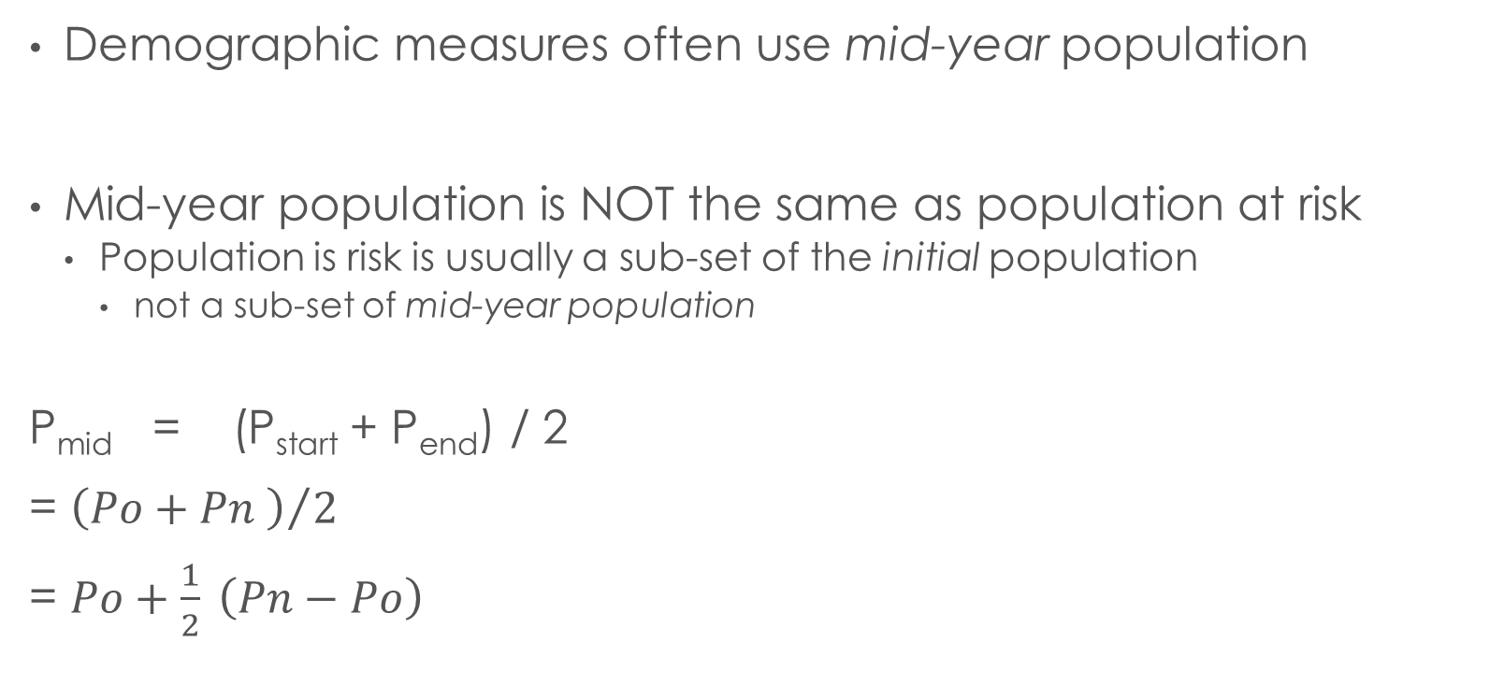
Mid-year population
Demographic measures often use mid-year population
Mid-year population is NOT the same as population at risk
  Population is risk is usually a sub-set of the initial population
    not a sub-set of mid-year population
P_{mid} = (P_{start} + P_{end}) / 2
= ${\left(Po+Pn \right)}/2$
= $Po+\frac{1}{2} \left(Pn−Po\right)$

Slide 16
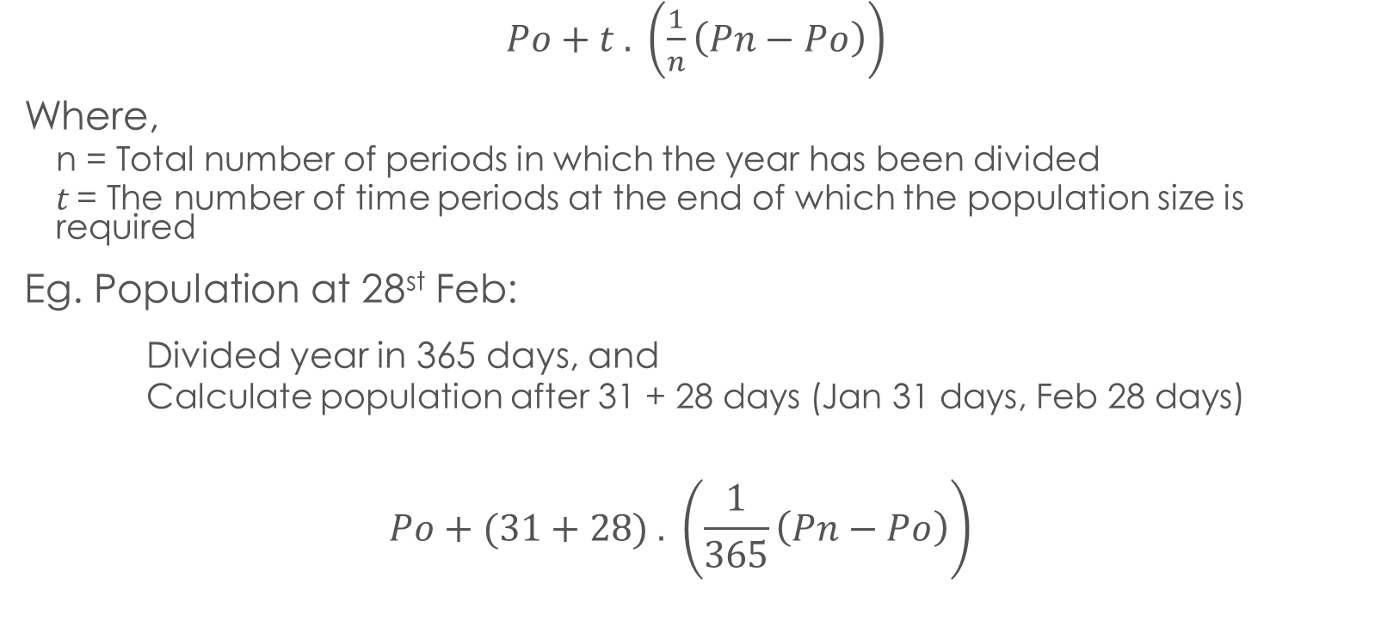
population size at any given Point in a year
Average Rate of change over the period
$Po+t . \left(\frac{1}{n}\left(Pn−Po\right)\right)$
Where,
  n = Total number of periods in which the year has been divided
  t = The number of time periods at the end of which the population size is required
Eg. Population at 28st Feb:
Divided year in 365 days, and
  Calculate population after 31 + 28 days (Jan 31 days, Feb 28 days)
$$Po+(31+28) . \left(\frac{1}{365}\left(Pn−Po\right)\right)$$

Slide 17
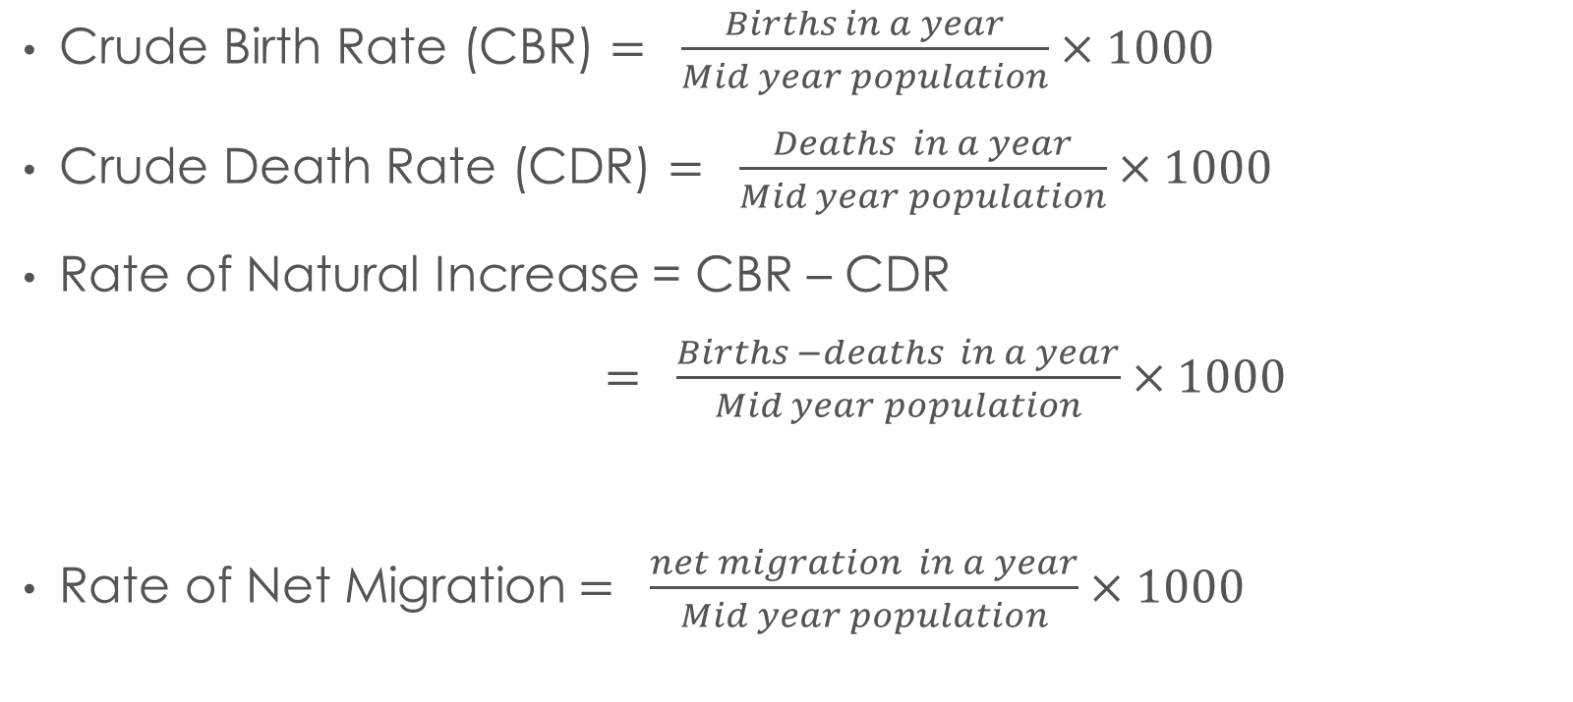
Basic Measures of Population Change
Crude Birth Rate (CBR) $= \frac{Births in a year}{Mid year population}×1000$
Crude Death Rate (CDR) $= \frac{Deaths in a year}{Mid year population}×1000$
Rate of Natural Increase = CBR – CDR
$= \frac{Births −deaths in a year}{Mid year population}×1000$
Rate of Net Migration$= \frac{net migration in a year}{Mid year population}×1000$

Slide 19
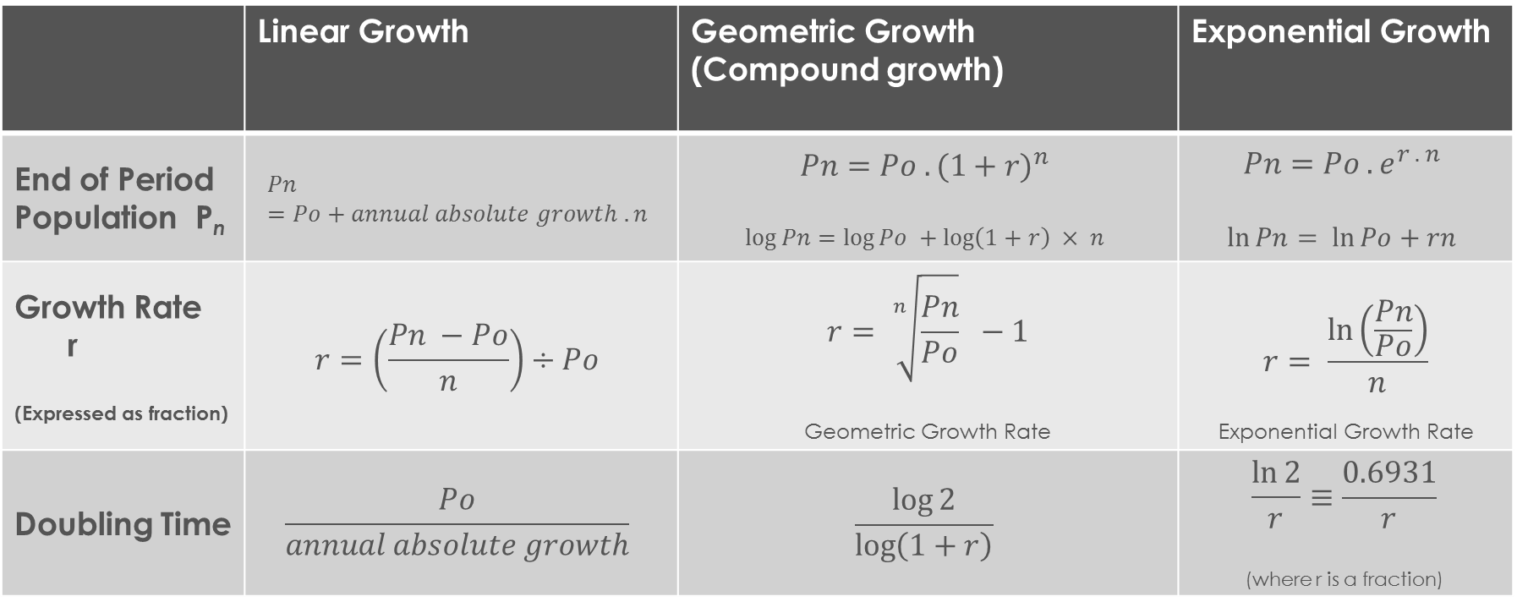
Measures of population CHange
 | Linear Growth | Geometric Growth (Compound growth) | Exponential Growth
End of Period Population P_{n} | $$Pn=Po+annual absolute growth .n$$ | $$Pn=Po . {(1+r)}^{n}$$ $$\log{Pn=\log{Po +\log\left(1+r\right) × n}}$$ | $$Pn=Po . e^{r . n}$$ $$\ln{Pn= \ln{Po+rn}}$$
Growth Rate r (Expressed as fraction) | $$r=\left(\frac{Pn −Po}{n}\right)÷Po$$ | $$r= \sqrt[n]{\frac{Pn}{Po}} −1$$ Geometric Growth Rate | $$r= \frac{\ln\left(\frac{Pn}{Po}\right)}{n}$$ Exponential Growth Rate
Doubling Time | $$\frac{Po}{annual absolute growth}$$ | $$\frac{\log{2}}{\log\left(1+r\right)}$$ | $$\frac{\ln{2}}{r}≡\frac{0.6931}{r}$$ (where r is a fraction)

Slide 20


Slide 21
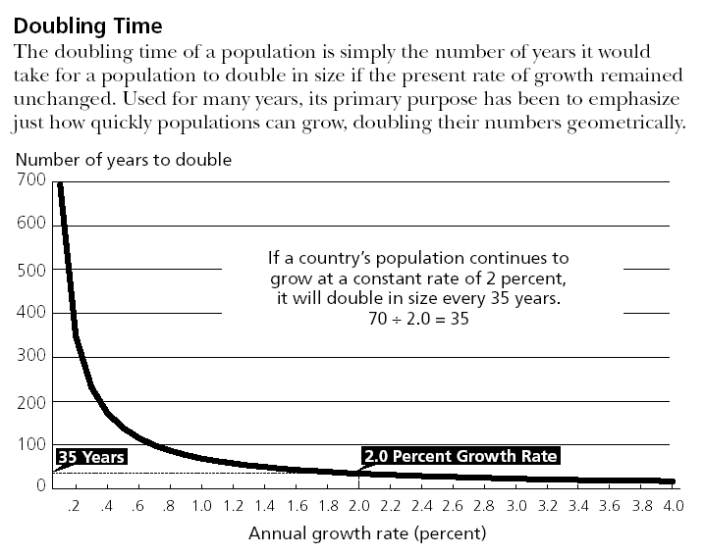
LAW OF 70
Based on exponential growth
Mathematical Relationship is
rt = 69.31
Where,
r = Annual Growth rate in percentage
t = Time in years

Slide 22
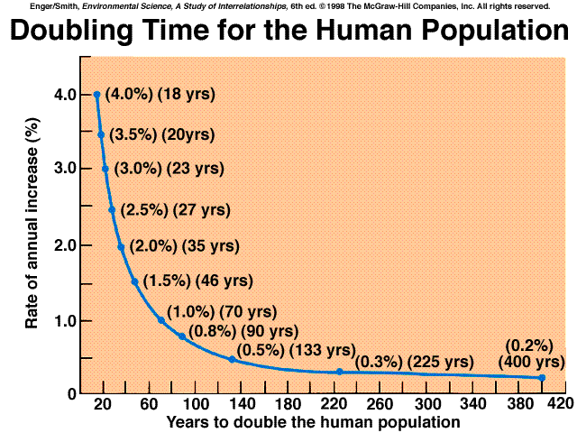

Slide 23
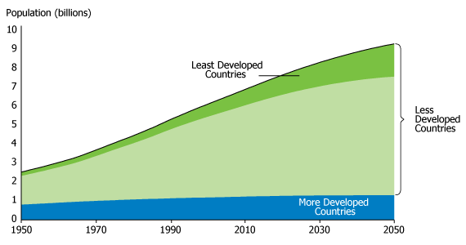
Growth of World Population
Source: United Nations Population Division, World Population Prospects: The 2010 Revision,medium variant (2011).

Slide 24
India’s Population GrOWTH
National Health Profile 2011

Slide 26
Age and Sex Composition

Slide 27
Age
The most important variable in demographic analysis
  Age at Last Birthday generally used
  Most difficult characteristic to be ascertained in view of high illiteracy rates in India
Mean Age of a Population - weighed average of the population distribution by age

Slide 28
Age Structure
Influences future demographic events
Social and economic conditions vary with age
Knowing age structure of utmost importance to a planner

Slide 29
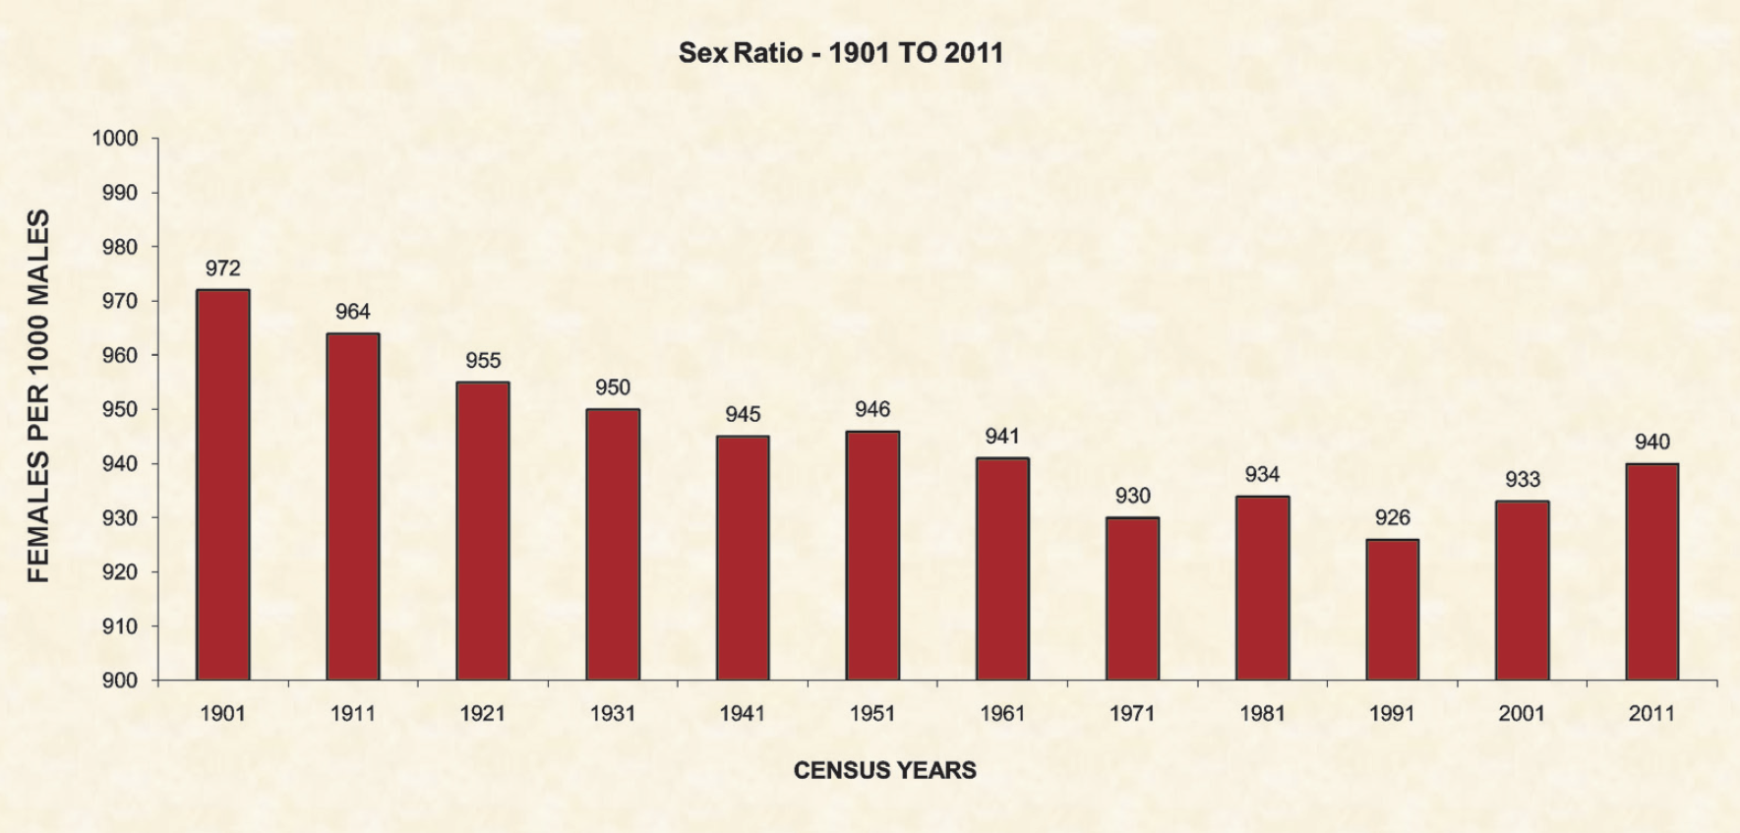
National Health Profile 2011

Slide 30
Population Pyramid
Age and Sex composition of a population
Male population kept on left hand side
Female population kept on right hand side
Pyramid starts with lower ages
Advisable to drop the open ended age group at oldest ages
Population can be in Actual figures or Percentage

Slide 31
Age Structure
Affected by process of
  Births – most important determinant
  Deaths –
    infant deaths
    adult deaths – distributed uniformly over all ages
  Migration – can cause changes in structure as age selective process – young adults
Population ages when fertility declines resulting in fewer births.

Slide 32
National Health Profile 2011

Slide 33
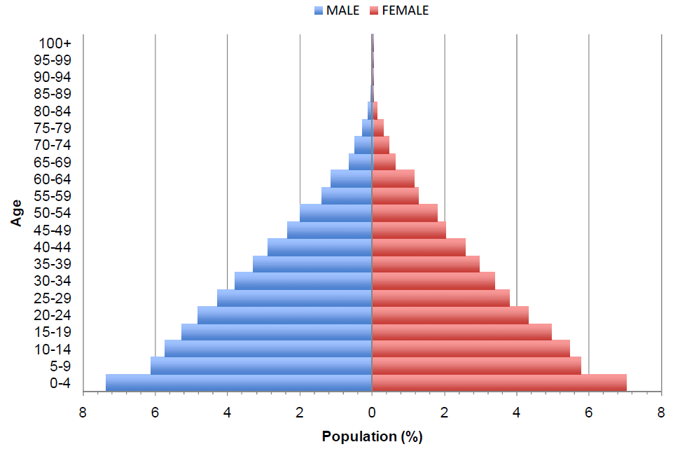
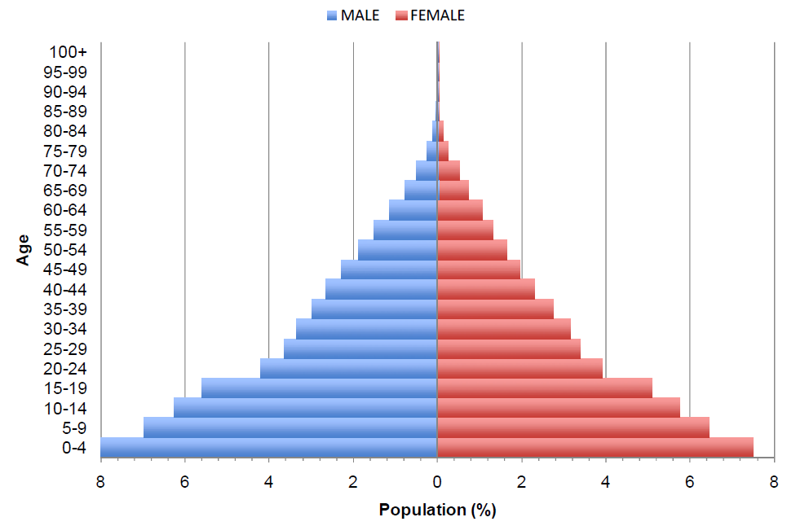
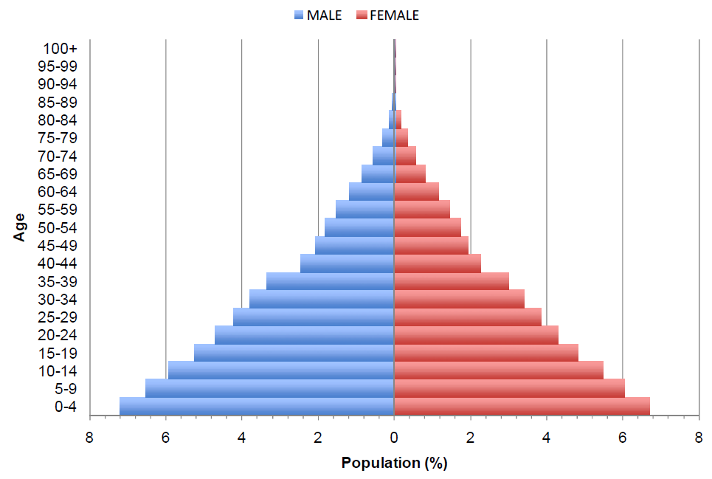
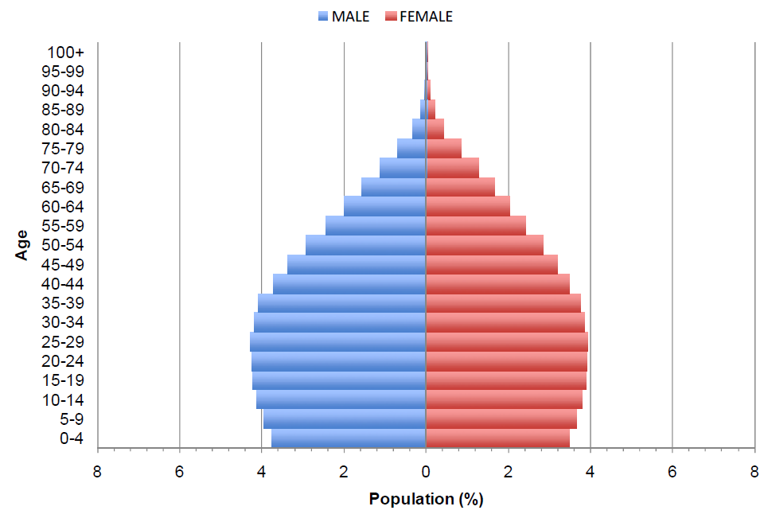
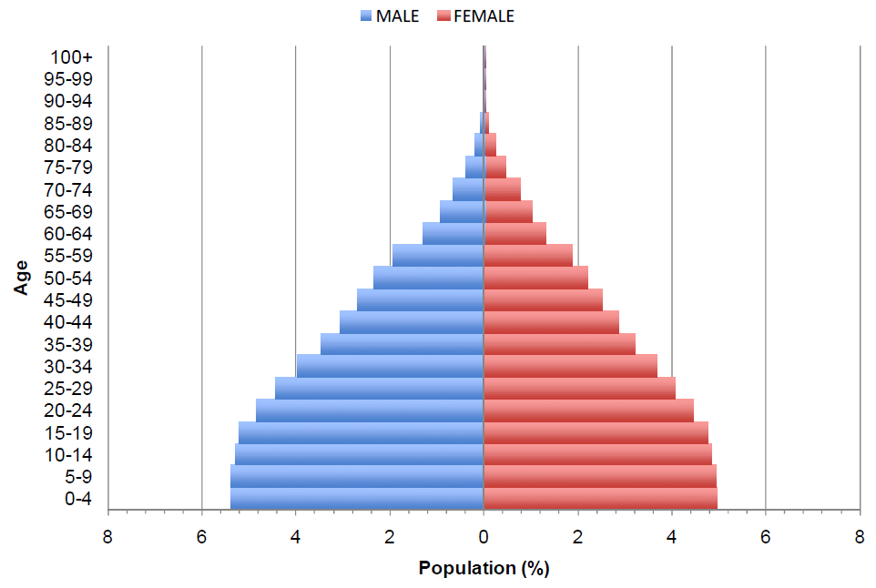
1950
1970
1990
2030
2010
Notes:
http://southasiainstitute.harvard.edu/website/wp-content/uploads/2012/08/Bloom_PopulationdynamicsiIndia.pdf

Slide 34
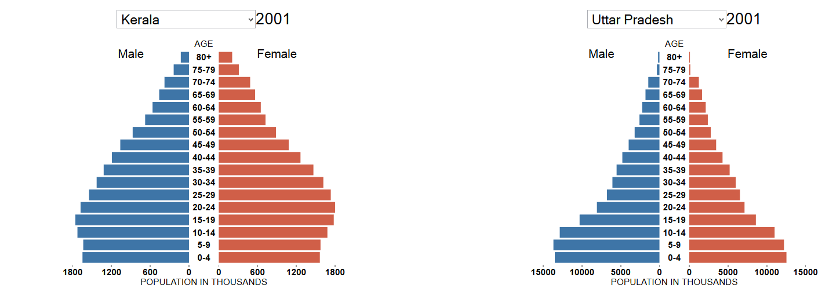
http://www.sciencemag.org/site/special/population/1207969-james-f4.xhtml?utm_content=short&utm_medium=magazine&utm_campaign=science&utm_source=shortener

Slide 36
Measures of Age-sex composition
Sex ratio
  Males per 100 females: Internationally
  Females per 1000 males: used in India
Dependency ratio Ratio P₀₋₁₄ + P₆₅₊ to P₁₅₋₆₄
  Child dependency ratio
  Aged dependency ratio
  Economic dependency ratio
Ageing Index Ratio of P₆₅₊ to P ₀₋₁₄
Caretaker ratio Ratio of P₈₀₊ to Females in P₅₀₋₆₄

Slide 37
Sex composition
Sex Ratio –
    Number of female in a population at specified time
    Number of males in a population at specified time
Age Specific ratios can also be calculated
Important as demographic events such as fertility are sex specific
Also differences between death rates of sexes
X 1000

Slide 38
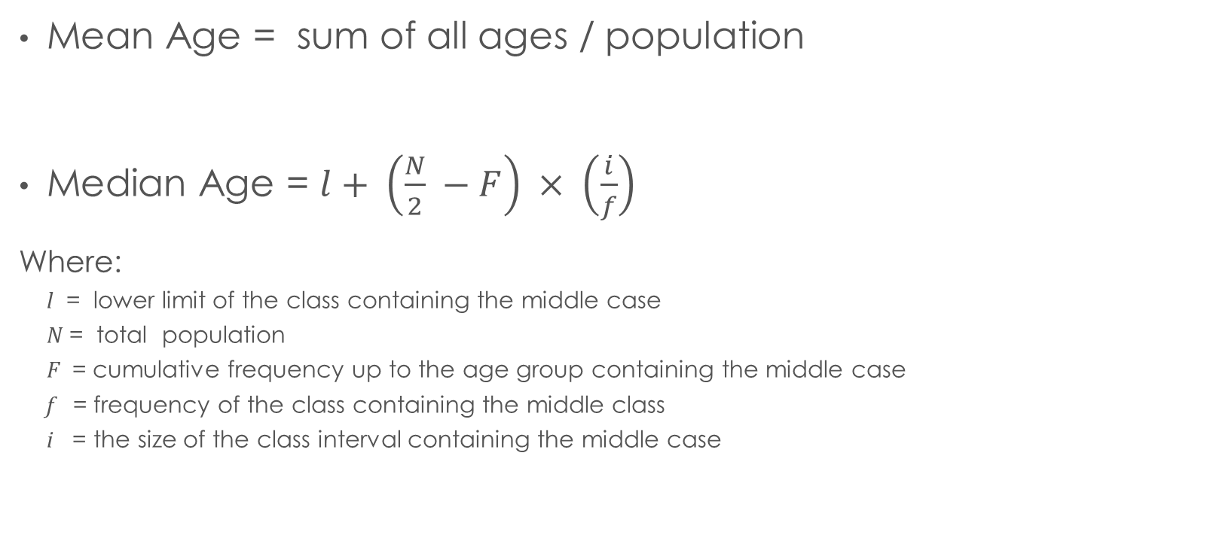
Measures of Central Age
Mean Age = sum of all ages / population
Median Age = $l+ \left(\frac{N}{2} −F\right) × \left(\frac{i}{f}\right)$
Where:
  l = lower limit of the class containing the middle case
  N = total population
  F = cumulative frequency up to the age group containing the middle case
  f = frequency of the class containing the middle class
  i = the size of the class interval containing the middle case

Slide 39
Dependency Ratio
P₀₋₁₄ + P₆₅₊
P₁₅₋₆₄
Measure of economic dependence in a population
Separate Child Dependency Ratio and Old Age Dependency Ratio can also be calculated
x100

Slide 40
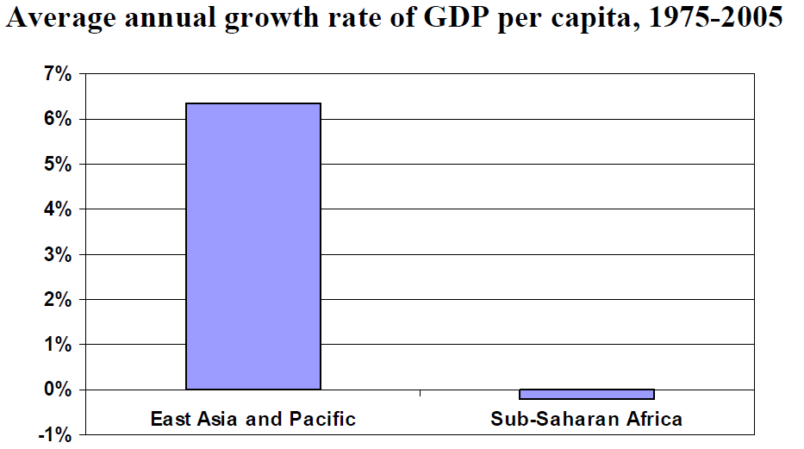
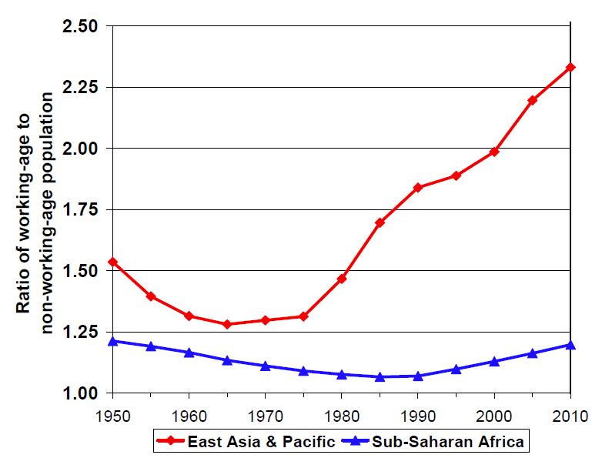
Notes:
http://southasiainstitute.harvard.edu/website/wp-content/uploads/2012/08/Bloom_PopulationdynamicsiIndia.pdf

Slide 41
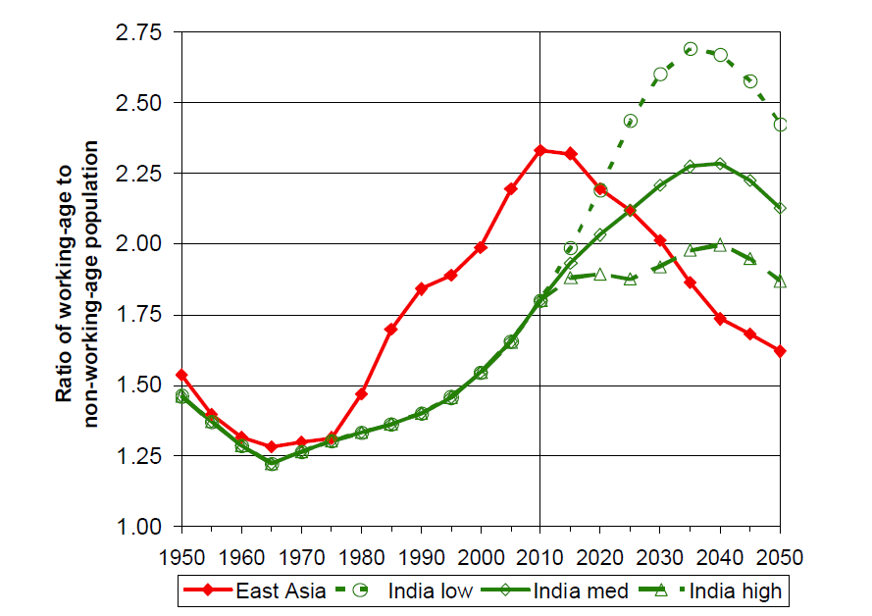
Notes:
http://southasiainstitute.harvard.edu/website/wp-content/uploads/2012/08/Bloom_PopulationdynamicsiIndia.pdf

Slide 42
Age Structure
Baby boomers - half of U.S. population; use most of goods and services; make political and economic decision
baby-bust generation - born since 1965; may have to pay more income, health care and social security to support retired baby boomers; but face less job competition
Better health may --> later retirement of baby boomers --> keep high-salary jobs

Slide 43
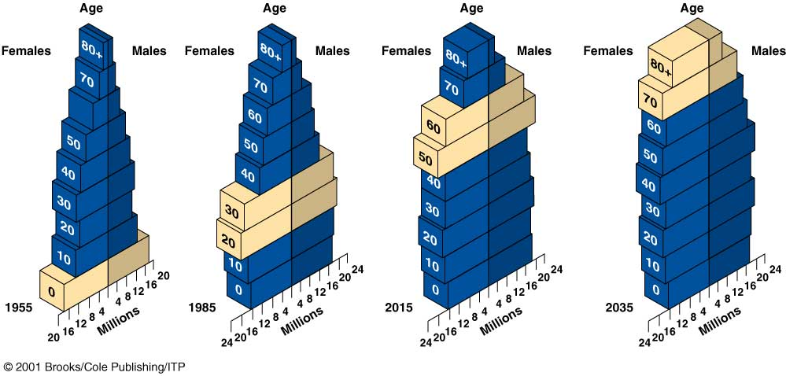
Tracking the baby-boom generation in the United States

Slide 44
Demographic Dividend
Accelerated economic growth that may result from a decline in a country's birth and death rates and the subsequent change in the age structure of the population.
With fewer births each year, a country's young dependent population declines in relation to the working-age population.
With fewer people to support, a country has a window of opportunity for rapid economic growth if the right social and economic policies are developed and investments made.

Slide 45
Errors in Age DAta
  Centenarians - Those close to 100 years tend to overestimate their age
  Understatement - Women tend to understate their age
  Overstatement: Mothers tend to round up the age of their children
  Heaping/Digit preference
    People tend to report certain ages at the expense of others
    Can occur at any digit but happens most often with 0 and 5
  Coverage—Missed or counted twice
    There is a tendency to miss the people in certain age groups (e.g. young men)
    Some people are counted twice

Slide 46
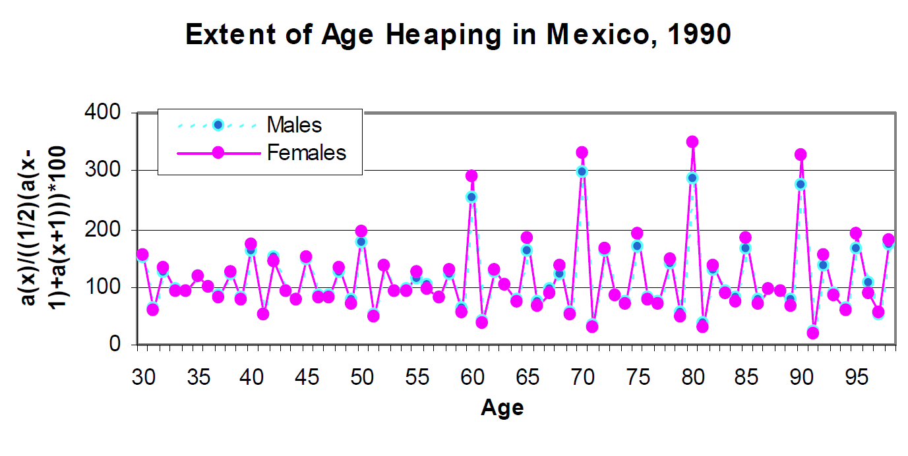

Slide 47
Age Ratio
Age ratio for an age group – the number of persons in that age group divided by the number obtained from adding one half of the numbers in the preceding and the next age group
Eg. For a five year age group
₅P_{a}
0.5(₅P_{a-5} + ₅P_{a+5})
Used primarily for checking net age misreporting
X 100

Slide 48
Comparing Populations

Slide 49
Comparing Populations
Comparing Rates
  CDR_{CountryA} compared with CDR_{CountryB}
  Age specific death rates of Males vs Age-specific death rates of females
  Sometimes, Ratio of country A vs Counry B are calculated: Rate Ratios
    How these differ from rate-ratios calculated in epidemiology ?
      (Hint. denominator)
Reasons for variations in across populations
  Demographic (age-sex) composition of the populations different
  Demographic (age-sex) composition of the populations similar but age-sex specific rates vary
  Quality of data varying across populations: under-reporting, mis-reporting,

Slide 50
Standardization
Enables appropriate comparisons after accounting for differences in
  Demographic (age-sex) composition
  Age-sex specific rates
Two Types
  Direct Standardization
  Indirect Standardization
History: http://www.who.int/healthinfo/paper31.pdf

Slide 51
Direct standardization
Choose a standard population
  What is the standard population ??
    One of the populations: Country A / B / C
    Sum of populations: Country A + B + C…
    International standard population
    Any other population..
  Choose an Informative standard population

Slide 52
Standard Population Distribution (percent)
Age Group | Segi (“world”) standard | Scandinavian (“European”) standard | The New WHO World Standard
0- 4 | 12.00 | 8.00 | 8.86
5- 9 | 10.00 | 7.00 | 8.69
10-14 | 9.00 | 7.00 | 8.60
15-19 | 9.00 | 7.00 | 8.47
20-24 | 8.00 | 7.00 | 8.22
25-29 | 8.00 | 7.00 | 7.93
30-34 | 6.00 | 7.00 | 7.61
35-39 | 6.00 | 7.00 | 7.15
40-44 | 6.00 | 7.00 | 6.59
45-49 | 6.00 | 7.00 | 6.04
50-54 | 5.00 | 7.00 | 5.37
55-59 | 4.00 | 6.00 | 4.55
60-64 | 4.00 | 5.00 | 3.72
65-69 | 3.00 | 4.00 | 2.96
70+ | 2.00 | 3.00 | 2.21
75-79 | 1.00 | 2.00 | 1.52
80-84 | 0.50 | 1.00 | 0.91
85+ | 0.50 | 1.00 | 0.63
Total | 100.00 | 100.00 | 100.00
 | Segi M. Cancer mortality for selected sites in 24 countries (1950-57). Department of Public Health, Tohoku University of Medicine, Sendai, Japan. 1960. | Doll R, & Cook P. Summarizing indices for comparison of cancer incidence data. Int J Cancer 2:269-79, 1967. | Ahmad OA, Boschi-Pinto C, Lopez AD, Murray CJL, Lozano R, Inoue M. Age standardization of rates: A new WHO standard. GPE Discussion Paper Series: No.31 EIP/GPE/EBD. World Health Organization 2001

Slide 53
Direct standardization
Calculate age specific death rates (ASDRs) for each population
  Do not round off the rates too much
Calculate the Expected number of deaths in each age-group in the standard population based on ASDRs of first population
Calculate the TOTAL Expected number of deaths across ALL age-group in the standard population based on ASDRs of first population
Calculate the Age-standardized Crude Death Rate for first population
Repeat the process for each population being compared
Compare the Age-standardized Crude Death Rates of various populations

Slide 54
Country | Australia |  |  |  | Australia
Year | 1921 |  |  |  | 1981
 | Population | Deaths |  |  | Population | Deaths
0- 4 | 600206 | 11980 |  |  | 1111945 | 2772
5- 9 | 595758 | 1168 |  |  | 1249941 | 327
10-14 | 529040 | 795 |  |  | 1295018 | 319
15-19 | 464217 | 985 |  |  | 1259029 | 1075
20-24 | 454027 | 1385 |  |  | 1247783 | 1260
25-29 | 462449 | 1734 |  |  | 1184149 | 1089
30-34 | 449322 | 1951 |  |  | 1192232 | 1076
35-39 | 387132 | 2168 |  |  | 977233 | 1238
40-44 | 331518 | 2151 |  |  | 822701 | 1674
45-49 | 280477 | 2376 |  |  | 723139 | 2621
50-54 | 256066 | 2899 |  |  | 757544 | 4459
55-59 | 215914 | 3488 |  |  | 726485 | 6942
60-64 | 169342 | 4116 |  |  | 599732 | 8734
65-69 | 104998 | 3877 |  |  | 524885 | 12286
70+ | 135268 | 12616 |  |  | 904514 | 61192
Total | 5435734 | 53689 |  |  | 14576330 | 107064
Crude death rate
9.88
7.34

Slide 55
Calculate Age Specific Death Rates
Country | Australia |  |  |  | Australia
Year | 1921 |  |  |  | 1981
 | Population | Deaths | ASDR |  | Population | Deaths | ASDR
0- 4 | 600206 | 11980 | 19.95991 |  | 1111945 | 2772 | 2.492918
5- 9 | 595758 | 1168 | 1.960496 |  | 1249941 | 327 | 0.261942
10-14 | 529040 | 795 | 1.502897 |  | 1295018 | 319 | 0.246041
15-19 | 464217 | 985 | 2.120853 |  | 1259029 | 1075 | 0.853939
20-24 | 454027 | 1385 | 3.050719 |  | 1247783 | 1260 | 1.009603
25-29 | 462449 | 1734 | 3.7505 |  | 1184149 | 1089 | 0.919698
30-34 | 449322 | 1951 | 4.341128 |  | 1192232 | 1076 | 0.90252
35-39 | 387132 | 2168 | 5.599584 |  | 977233 | 1238 | 1.267231
40-44 | 331518 | 2151 | 6.487855 |  | 822701 | 1674 | 2.034699
45-49 | 280477 | 2376 | 8.469647 |  | 723139 | 2621 | 3.624794
50-54 | 256066 | 2899 | 11.32285 |  | 757544 | 4459 | 5.885668
55-59 | 215914 | 3488 | 16.15607 |  | 726485 | 6942 | 9.555927
60-64 | 169342 | 4116 | 24.30529 |  | 599732 | 8734 | 14.56282
65-69 | 104998 | 3877 | 36.92904 |  | 524885 | 12286 | 23.40685
70+ | 135268 | 12616 | 93.26414 |  | 904514 | 61192 | 67.65162
Total | 5435734 | 53689 |  |  | 14576330 | 107064

Slide 56
Chose a standard population, calculate expected Deaths
Country | Australia |  |  |  | Australia
Year | 1921 |  |  |  | 1981 |  |  |  | Expected deaths in standard population based on ASDRs of 1921
 | Population | Deaths | ASDR |  | Population | Deaths | ASDR
0- 4 | 600206 | 11980 | 19.95991 |  | 1111945 | 2772 | 2.492918 |  | 22194.32
5- 9 | 595758 | 1168 | 1.960496 |  | 1249941 | 327 | 0.261942 |  | 2450.504
10-14 | 529040 | 795 | 1.502897 |  | 1295018 | 319 | 0.246041 |  | 1946.278
15-19 | 464217 | 985 | 2.120853 |  | 1259029 | 1075 | 0.853939 |  | 2670.215
20-24 | 454027 | 1385 | 3.050719 |  | 1247783 | 1260 | 1.009603 |  | 3806.636
25-29 | 462449 | 1734 | 3.7505 |  | 1184149 | 1089 | 0.919698 |  | 4441.15
30-34 | 449322 | 1951 | 4.341128 |  | 1192232 | 1076 | 0.90252 |  | 5175.632
35-39 | 387132 | 2168 | 5.599584 |  | 977233 | 1238 | 1.267231 |  | 5472.099
40-44 | 331518 | 2151 | 6.487855 |  | 822701 | 1674 | 2.034699 |  | 5337.565
45-49 | 280477 | 2376 | 8.469647 |  | 723139 | 2621 | 3.624794 |  | 6124.732
50-54 | 256066 | 2899 | 11.32285 |  | 757544 | 4459 | 5.885668 |  | 8577.556
55-59 | 215914 | 3488 | 16.15607 |  | 726485 | 6942 | 9.555927 |  | 11737.14
60-64 | 169342 | 4116 | 24.30529 |  | 599732 | 8734 | 14.56282 |  | 14576.66
65-69 | 104998 | 3877 | 36.92904 |  | 524885 | 12286 | 23.40685 |  | 19383.5
70+ | 135268 | 12616 | 93.26414 |  | 904514 | 61192 | 67.65162 |  | 84358.72
Total | 5435734 | 53689 |  |  | 14576330 | 107064
Standard

Slide 57
Calculate Total Expected Deaths
Country | Australia |  |  |  | Australia
Year | 1921 |  |  |  | 1981 |  |  |  | Expected deaths in standard population based on ASDRs of 1921
 | Population | Deaths | ASDR |  | Population | Deaths | ASDR
0- 4 | 600206 | 11980 | 19.95991 |  | 1111945 | 2772 | 2.492918 |  | 22194.32
5- 9 | 595758 | 1168 | 1.960496 |  | 1249941 | 327 | 0.261942 |  | 2450.504
10-14 | 529040 | 795 | 1.502897 |  | 1295018 | 319 | 0.246041 |  | 1946.278
15-19 | 464217 | 985 | 2.120853 |  | 1259029 | 1075 | 0.853939 |  | 2670.215
20-24 | 454027 | 1385 | 3.050719 |  | 1247783 | 1260 | 1.009603 |  | 3806.636
25-29 | 462449 | 1734 | 3.7505 |  | 1184149 | 1089 | 0.919698 |  | 4441.15
30-34 | 449322 | 1951 | 4.341128 |  | 1192232 | 1076 | 0.90252 |  | 5175.632
35-39 | 387132 | 2168 | 5.599584 |  | 977233 | 1238 | 1.267231 |  | 5472.099
40-44 | 331518 | 2151 | 6.487855 |  | 822701 | 1674 | 2.034699 |  | 5337.565
45-49 | 280477 | 2376 | 8.469647 |  | 723139 | 2621 | 3.624794 |  | 6124.732
50-54 | 256066 | 2899 | 11.32285 |  | 757544 | 4459 | 5.885668 |  | 8577.556
55-59 | 215914 | 3488 | 16.15607 |  | 726485 | 6942 | 9.555927 |  | 11737.14
60-64 | 169342 | 4116 | 24.30529 |  | 599732 | 8734 | 14.56282 |  | 14576.66
65-69 | 104998 | 3877 | 36.92904 |  | 524885 | 12286 | 23.40685 |  | 19383.5
70+ | 135268 | 12616 | 93.26414 |  | 904514 | 61192 | 67.65162 |  | 84358.72
Total | 5435734 | 53689 |  |  | 14576330 | 107064 |  |  | 198252.7
Standard

Slide 58
Calculate age standardized death rate for 1921
Country | Australia |  |  |  | Australia
Year | 1921 |  |  |  | 1981 |  |  |  | Expected deaths in standard population based on ASDRs of 1921
 | Population | Deaths | ASDR |  | Population | Deaths | ASDR
0- 4 | 600206 | 11980 | 19.95991 |  | 1111945 | 2772 | 2.492918 |  | 22194.32
5- 9 | 595758 | 1168 | 1.960496 |  | 1249941 | 327 | 0.261942 |  | 2450.504
10-14 | 529040 | 795 | 1.502897 |  | 1295018 | 319 | 0.246041 |  | 1946.278
15-19 | 464217 | 985 | 2.120853 |  | 1259029 | 1075 | 0.853939 |  | 2670.215
20-24 | 454027 | 1385 | 3.050719 |  | 1247783 | 1260 | 1.009603 |  | 3806.636
25-29 | 462449 | 1734 | 3.7505 |  | 1184149 | 1089 | 0.919698 |  | 4441.15
30-34 | 449322 | 1951 | 4.341128 |  | 1192232 | 1076 | 0.90252 |  | 5175.632
35-39 | 387132 | 2168 | 5.599584 |  | 977233 | 1238 | 1.267231 |  | 5472.099
40-44 | 331518 | 2151 | 6.487855 |  | 822701 | 1674 | 2.034699 |  | 5337.565
45-49 | 280477 | 2376 | 8.469647 |  | 723139 | 2621 | 3.624794 |  | 6124.732
50-54 | 256066 | 2899 | 11.32285 |  | 757544 | 4459 | 5.885668 |  | 8577.556
55-59 | 215914 | 3488 | 16.15607 |  | 726485 | 6942 | 9.555927 |  | 11737.14
60-64 | 169342 | 4116 | 24.30529 |  | 599732 | 8734 | 14.56282 |  | 14576.66
65-69 | 104998 | 3877 | 36.92904 |  | 524885 | 12286 | 23.40685 |  | 19383.5
70+ | 135268 | 12616 | 93.26414 |  | 904514 | 61192 | 67.65162 |  | 84358.72
Total | 5435734 | 53689 |  |  | 14576330 | 107064 |  |  | 198252.7
Standard
Age standardized death rate for Australia in 1921 = 198252.7 / 1456330 * 1000 = 13.06

Slide 59
Calculate age standardized death rate for 1921
Country | Australia |  |  |  | Australia
Year | 1921 |  |  |  | 1981 |  |  |  | Expected deaths in standard population based on ASDRs of 1921
 | Population | Deaths | ASDR |  | Population | Deaths | ASDR
0- 4 | 600206 | 11980 | 19.95991 |  | 1111945 | 2772 | 2.492918 |  | 22194.32
5- 9 | 595758 | 1168 | 1.960496 |  | 1249941 | 327 | 0.261942 |  | 2450.504
10-14 | 529040 | 795 | 1.502897 |  | 1295018 | 319 | 0.246041 |  | 1946.278
15-19 | 464217 | 985 | 2.120853 |  | 1259029 | 1075 | 0.853939 |  | 2670.215
20-24 | 454027 | 1385 | 3.050719 |  | 1247783 | 1260 | 1.009603 |  | 3806.636
25-29 | 462449 | 1734 | 3.7505 |  | 1184149 | 1089 | 0.919698 |  | 4441.15
30-34 | 449322 | 1951 | 4.341128 |  | 1192232 | 1076 | 0.90252 |  | 5175.632
35-39 | 387132 | 2168 | 5.599584 |  | 977233 | 1238 | 1.267231 |  | 5472.099
40-44 | 331518 | 2151 | 6.487855 |  | 822701 | 1674 | 2.034699 |  | 5337.565
45-49 | 280477 | 2376 | 8.469647 |  | 723139 | 2621 | 3.624794 |  | 6124.732
50-54 | 256066 | 2899 | 11.32285 |  | 757544 | 4459 | 5.885668 |  | 8577.556
55-59 | 215914 | 3488 | 16.15607 |  | 726485 | 6942 | 9.555927 |  | 11737.14
60-64 | 169342 | 4116 | 24.30529 |  | 599732 | 8734 | 14.56282 |  | 14576.66
65-69 | 104998 | 3877 | 36.92904 |  | 524885 | 12286 | 23.40685 |  | 19383.5
70+ | 135268 | 12616 | 93.26414 |  | 904514 | 61192 | 67.65162 |  | 84358.72
Total | 5435734 | 53689 |  |  | 14576330 | 107064 |  |  | 198252.7
Standard
Crude death rate
9.88
7.34
Age standardized death rate for Australia in 1921 = 198252.7 / 1456330 * 1000 = 13.60

Slide 60
Crude death rate 1921 = 9.88
Age standardized death rate for Australia in 1921 = 13.6
Crude death rate 1981 (standard population) = 7.34
If we were to account for the differing age structures, the mortality in 1921 is nearly twice (13.06 / 7.34 ≈ 2 ) the mortality in 1981

Slide 61
Direct standardization: Summary
Chose one of the comparison populations (1981) as standard
Age Standardized Death Rate for Australia in 1921 can be directly compared against the CDR of 1981 population
If we choose a third population as a standard, the we would
    Calculate Age Standardized Death Rate for Australia in 1921
    Calculate Age Standardized Death Rate for Australia in 1981
    Compare the two Age Standardized Death Rates
It is possible to standardize on more than one variable: eg. age-sex standardization
  Requires knowledge of age-sex specific rates for all populations

Slide 62
Cautions
Choice of a standard can markedly alter comparisons between populations.

Slide 63
Interpreting standardized Rates
Standardized rates are artificial indices
Should only be used for making comparisons
Do not denote the actual events in the population
Age is only one of the factors influencing mortality
  Other factors not adjusted for by age standardization
Always compare age-specific rates across populations
  Is the pattern similar across various age-groups ?

Slide 64
Disadvantages of Direct Standardization
Requires knowledge the age/sex specific death rates for all populations being compared
Such detailed data often not available

Slide 65
Indirect Standardization
Provides a measure called standardized mortality ratio
Similar concept as direct standardization
Requires knowledge of
  Age/sex specific death rates of Standard Population
  Total Deaths in Populations of interest
  Age-structure of Populations of interest
  Does not Require Age-structure of deaths in Populations of Interest

Slide 66
Age specific death rates of only one population are known
Country | Australia |  |  |  | Australia
Year | 1921 |  |  |  | 1981
 | Population | Deaths |  |  | Population | Deaths
0- 4 | 600206 | ?? |  |  | 1111945 | 2772
5- 9 | 595758 | ?? |  |  | 1249941 | 327
10-14 | 529040 | ?? |  |  | 1295018 | 319
15-19 | 464217 | ?? |  |  | 1259029 | 1075
20-24 | 454027 | ?? |  |  | 1247783 | 1260
25-29 | 462449 | ?? |  |  | 1184149 | 1089
30-34 | 449322 | ?? |  |  | 1192232 | 1076
35-39 | 387132 | ?? |  |  | 977233 | 1238
40-44 | 331518 | ?? |  |  | 822701 | 1674
45-49 | 280477 | ?? |  |  | 723139 | 2621
50-54 | 256066 | ?? |  |  | 757544 | 4459
55-59 | 215914 | ?? |  |  | 726485 | 6942
60-64 | 169342 | ?? |  |  | 599732 | 8734
65-69 | 104998 | ?? |  |  | 524885 | 12286
70+ | 135268 | ?? |  |  | 904514 | 61192
Total | 5435734 | 53689 |  |  | 14576330 | 107064
Crude death rate
9.88
7.34

Slide 67
population with Known ASDR taken as standard
 |  |  |  |  | Standard Population
Country | Australia |  |  |  | Australia
Year | 1921 |  |  |  | 1981
 | Population | Deaths |  |  | Population | Deaths | ASDR
0- 4 | 600206 | ?? |  |  | 1111945 | 2772 | 2.492918
5- 9 | 595758 | ?? |  |  | 1249941 | 327 | 0.261942
10-14 | 529040 | ?? |  |  | 1295018 | 319 | 0.246041
15-19 | 464217 | ?? |  |  | 1259029 | 1075 | 0.853939
20-24 | 454027 | ?? |  |  | 1247783 | 1260 | 1.009603
25-29 | 462449 | ?? |  |  | 1184149 | 1089 | 0.919698
30-34 | 449322 | ?? |  |  | 1192232 | 1076 | 0.90252
35-39 | 387132 | ?? |  |  | 977233 | 1238 | 1.267231
40-44 | 331518 | ?? |  |  | 822701 | 1674 | 2.034699
45-49 | 280477 | ?? |  |  | 723139 | 2621 | 3.624794
50-54 | 256066 | ?? |  |  | 757544 | 4459 | 5.885668
55-59 | 215914 | ?? |  |  | 726485 | 6942 | 9.555927
60-64 | 169342 | ?? |  |  | 599732 | 8734 | 14.56282
65-69 | 104998 | ?? |  |  | 524885 | 12286 | 23.40685
70+ | 135268 | ?? |  |  | 904514 | 61192 | 67.65162
Total | 5435734 | 53689 |  |  | 14576330 | 107064
Crude death rate
9.88
7.34

Slide 68
Expected deaths in 1921 as per ASDR of standard population
 |  |  |  |  | Standard Population
Country | Australia |  |  |  | Australia
Year | 1921 |  |  |  | 1981
 | Population | Deaths | Expected Deaths |  | Population | Deaths | ASDR
0- 4 | 600206 | ?? | 1496 |  | 1111945 | 2772 | 2.492918
5- 9 | 595758 | ?? | 156 |  | 1249941 | 327 | 0.261942
10-14 | 529040 | ?? | 130 |  | 1295018 | 319 | 0.246041
15-19 | 464217 | ?? | 396 |  | 1259029 | 1075 | 0.853939
20-24 | 454027 | ?? | 458 |  | 1247783 | 1260 | 1.009603
25-29 | 462449 | ?? | 425 |  | 1184149 | 1089 | 0.919698
30-34 | 449322 | ?? | 406 |  | 1192232 | 1076 | 0.90252
35-39 | 387132 | ?? | 491 |  | 977233 | 1238 | 1.267231
40-44 | 331518 | ?? | 675 |  | 822701 | 1674 | 2.034699
45-49 | 280477 | ?? | 1017 |  | 723139 | 2621 | 3.624794
50-54 | 256066 | ?? | 1507 |  | 757544 | 4459 | 5.885668
55-59 | 215914 | ?? | 2063 |  | 726485 | 6942 | 9.555927
60-64 | 169342 | ?? | 2466 |  | 599732 | 8734 | 14.56282
65-69 | 104998 | ?? | 2458 |  | 524885 | 12286 | 23.40685
70+ | 135268 | ?? | 9151 |  | 904514 | 61192 | 67.65162
Total | 5435734 | 53689 | 23295 |  | 14576330 | 107064
Observed deaths in 1921 | O | 53689
Expected deaths in 1921 | E | 23295

Slide 69
 |  |  |  |  | Standard Population
Country | Australia |  |  |  | Australia
Year | 1921 |  |  |  | 1981
 | Population | Deaths | Expected Deaths |  | Population | Deaths | ASDR
0- 4 | 600206 | ?? | 1496 |  | 1111945 | 2772 | 2.492918
5- 9 | 595758 | ?? | 156 |  | 1249941 | 327 | 0.261942
10-14 | 529040 | ?? | 130 |  | 1295018 | 319 | 0.246041
15-19 | 464217 | ?? | 396 |  | 1259029 | 1075 | 0.853939
20-24 | 454027 | ?? | 458 |  | 1247783 | 1260 | 1.009603
25-29 | 462449 | ?? | 425 |  | 1184149 | 1089 | 0.919698
30-34 | 449322 | ?? | 406 |  | 1192232 | 1076 | 0.90252
35-39 | 387132 | ?? | 491 |  | 977233 | 1238 | 1.267231
40-44 | 331518 | ?? | 675 |  | 822701 | 1674 | 2.034699
45-49 | 280477 | ?? | 1017 |  | 723139 | 2621 | 3.624794
50-54 | 256066 | ?? | 1507 |  | 757544 | 4459 | 5.885668
55-59 | 215914 | ?? | 2063 |  | 726485 | 6942 | 9.555927
60-64 | 169342 | ?? | 2466 |  | 599732 | 8734 | 14.56282
65-69 | 104998 | ?? | 2458 |  | 524885 | 12286 | 23.40685
70+ | 135268 | ?? | 9151 |  | 904514 | 61192 | 67.65162
Total | 5435734 | 53689 | 23295 |  | 14576330 | 107064
Standardized Mortality Ratio | SMR = O / E | 2.30

Slide 70
 |  |  |  |  | Standard Population
Country | Australia |  |  |  | Australia
Year | 1921 |  |  |  | 1981
 | Population | Deaths | Expected Deaths |  | Population | Deaths | ASDR
0- 4 | 600206 | ?? | 1496 |  | 1111945 | 2772 | 2.492918
5- 9 | 595758 | ?? | 156 |  | 1249941 | 327 | 0.261942
10-14 | 529040 | ?? | 130 |  | 1295018 | 319 | 0.246041
15-19 | 464217 | ?? | 396 |  | 1259029 | 1075 | 0.853939
20-24 | 454027 | ?? | 458 |  | 1247783 | 1260 | 1.009603
25-29 | 462449 | ?? | 425 |  | 1184149 | 1089 | 0.919698
30-34 | 449322 | ?? | 406 |  | 1192232 | 1076 | 0.90252
35-39 | 387132 | ?? | 491 |  | 977233 | 1238 | 1.267231
40-44 | 331518 | ?? | 675 |  | 822701 | 1674 | 2.034699
45-49 | 280477 | ?? | 1017 |  | 723139 | 2621 | 3.624794
50-54 | 256066 | ?? | 1507 |  | 757544 | 4459 | 5.885668
55-59 | 215914 | ?? | 2063 |  | 726485 | 6942 | 9.555927
60-64 | 169342 | ?? | 2466 |  | 599732 | 8734 | 14.56282
65-69 | 104998 | ?? | 2458 |  | 524885 | 12286 | 23.40685
70+ | 135268 | ?? | 9151 |  | 904514 | 61192 | 67.65162
Total | 5435734 | 53689 | 23295 |  | 14576330 | 107064
CDR for 1921 | CDR₁₉₂₁ | 9.88
CDR for 1981 - Standard Population | CDRstd | 7.34
Observed deaths in 1921 | O | 53689
Expected deaths in 1921 | E | 23295
Standardized Mortality Ratio | SMR = O / E | 2.30
Indirectly standardized death rate for 1921 | CDRstd x SMR | 16.9

Slide 71
Interpretation of Indirectly standardized
Crude death rate 1981 (standard population) = 7.34
Crude death rate 1921 = 9.88
Indirectly standardized death rate 1921 = 16.9
Standardized Mortality Ratio = 2.30 (observed /expected deaths)
  Observed deaths in 1921 were 2.3 times higher than what was expected based on 1981 death rates.
    Thus mortality was higher in 1921
  Direct standardization: 1.8 times higher mortality
  (for comparison, the directly standardized death rate for Australia in 1921 was 13.6)

Slide 72
Drawbacks of Indirect Standardization
Indirect standardization does not keep age structure constant
  SMR calculation dependent on age structure each compared population
  The standard population has a separate age structure
  If multiple populations are being compared, each SMR will be based on different population composition
Direct standardization: all populations are brought to the same age structure as the standard population

Slide 73
Measures of Fertility

Slide 74
Measures of Fertility
Period Fertility
Cohort Fertility
Events in current period studied in relation to durations of exposure of population during the same period
Cross-Sectional / snapshot measures
Events studied in well defined cohorts as they move over time
A long-run view of family building throughout a woman’s reproductive years
Two types:
  Real cohorts
  Synthetic / Hypothetical cohorts

Slide 75
Period Measures of Fertility

Slide 76
Period Measures of Fertility
Total Births: in an year
Rate of Natural Increase: (live births - deaths)/ mid-yr pop*1000
Crude Birth Rate: live births/mid-yr pop * 1000
Child-woman Ratio
General Fertility Rate
Age-specific Fertility Rate
Age Specific Marital Fertility Rate

Slide 77
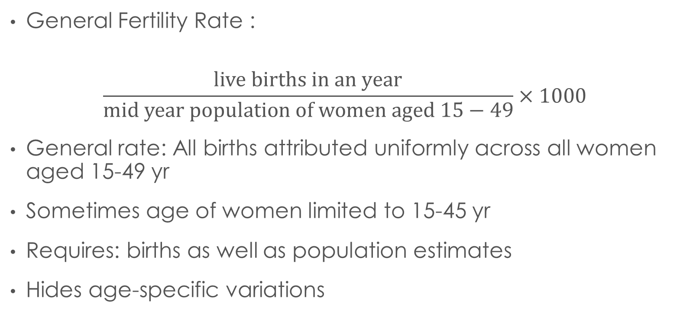
Period Measures of Fertility
General Fertility Rate :
$$\frac{live births in an year}{mid year population of women aged 15−49}×1000$$
General rate: All births attributed uniformly across all women aged 15-49 yr
Sometimes age of women limited to 15-45 yr
Requires: births as well as population estimates
Hides age-specific variations

Slide 78
Period Measures of Fertility
Crude Birth Rate
  Not a rate but a ratio
  Affected greatly by age-sex composition and other characteristics of population
  Not suited for comparison among different populations

Slide 79
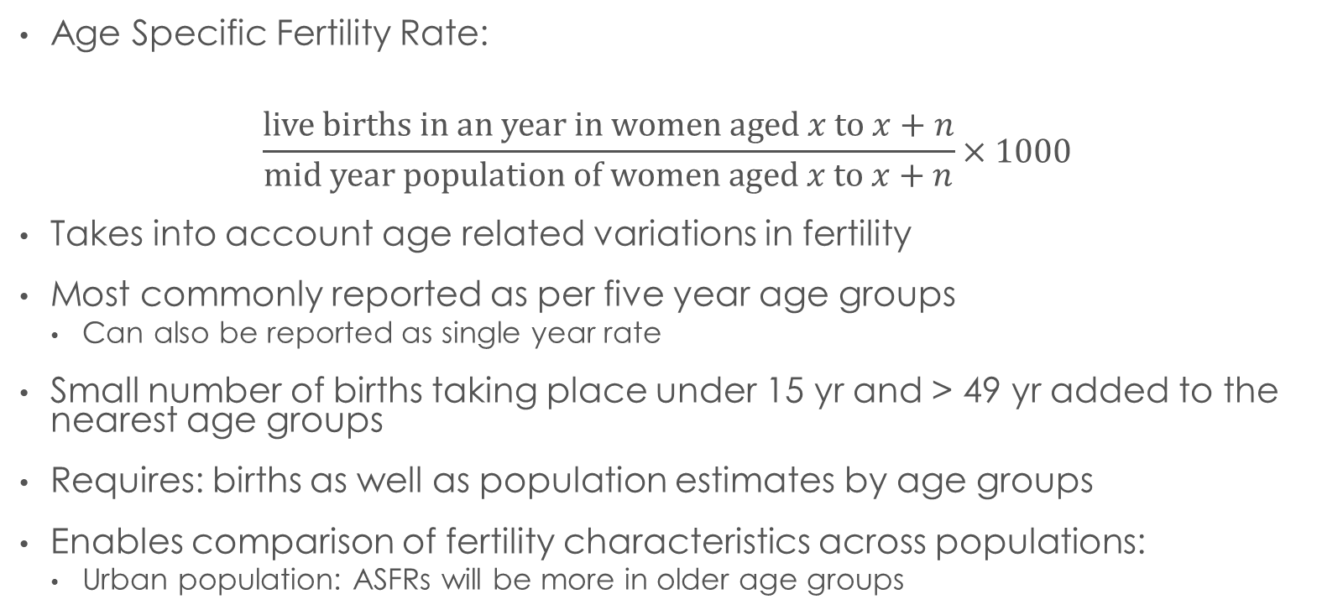
Period Measures of Fertility
Age Specific Fertility Rate:
$$\frac{live births in an year in women aged x to x+n}{mid year population of women aged x to x+n}×1000$$
Takes into account age related variations in fertility
Most commonly reported as per five year age groups
  Can also be reported as single year rate
Small number of births taking place under 15 yr and > 49 yr added to the nearest age groups
Requires: births as well as population estimates by age groups
Enables comparison of fertility characteristics across populations:
  Urban population: ASFRs will be more in older age groups

Slide 80
Fertility Data in surveys: issues and challenges
Information on complete birth histories of women ages 15-49 years
  Accurateness and completeness information
  Births of children who died very young may be under-reported
NFHS-3
  Birth histories for three years (2003-2005) preceding survey collected
    For each married woman: births, age of woman at birth
  ASFR for any specific age group
    Numerator: number of births to women in that age group in
    Denominator: Woman-years lived by women in that age group

Slide 81
Age Specific Fertility Rates (Karnataka, 2011)

Slide 82
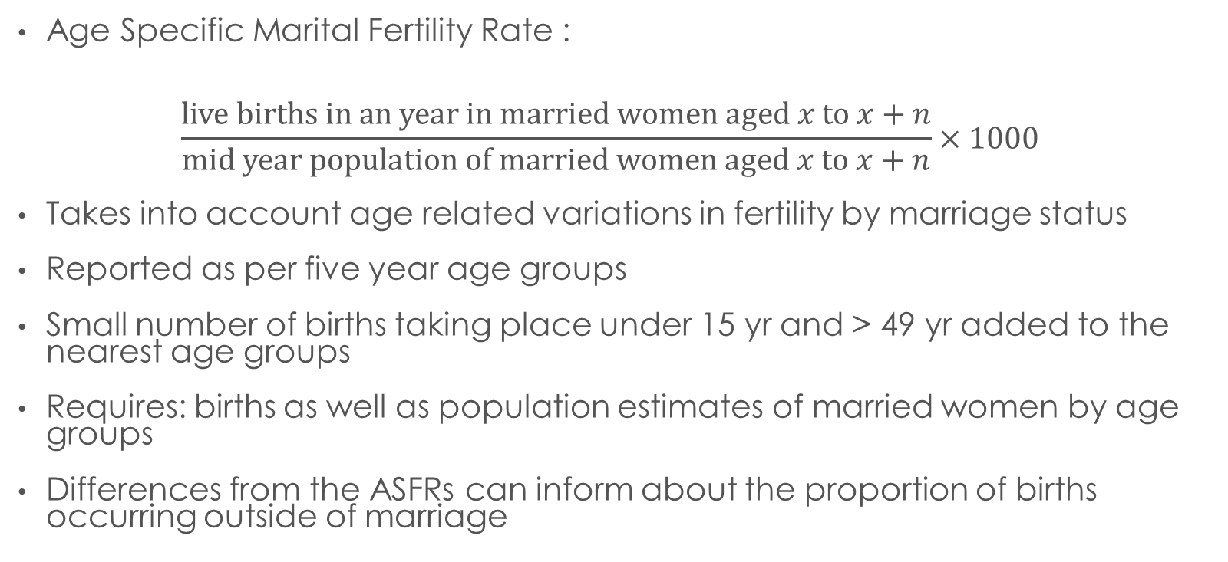
Period Measures of Fertility
Age Specific Marital Fertility Rate :
$$\frac{live births in an year in married women aged x to x+n}{mid year population of married women aged x to x+n}×1000$$
Takes into account age related variations in fertility by marriage status
Reported as per five year age groups
Small number of births taking place under 15 yr and > 49 yr added to the nearest age groups
Requires: births as well as population estimates of married women by age groups
Differences from the ASFRs can inform about the proportion of births occurring outside of marriage

Slide 83
Age Specific marital Fertility Rates (Karnataka, 2011)

Slide 84
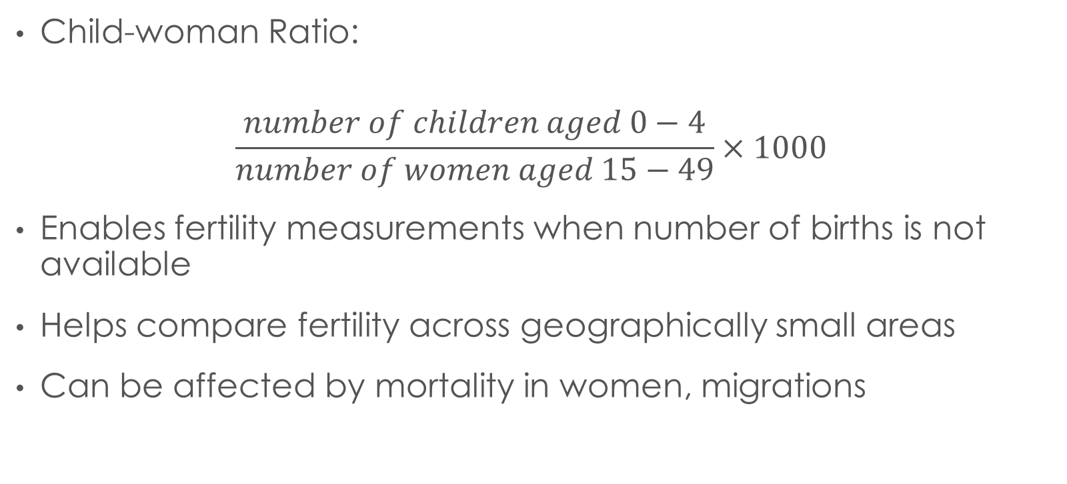
Period Measures of Fertility
Child-woman Ratio:
$$\frac{number of children aged 0−4}{number of women aged 15−49}×1000$$
Enables fertility measurements when number of births is not available
Helps compare fertility across geographically small areas
Can be affected by mortality in women, migrations

Slide 85
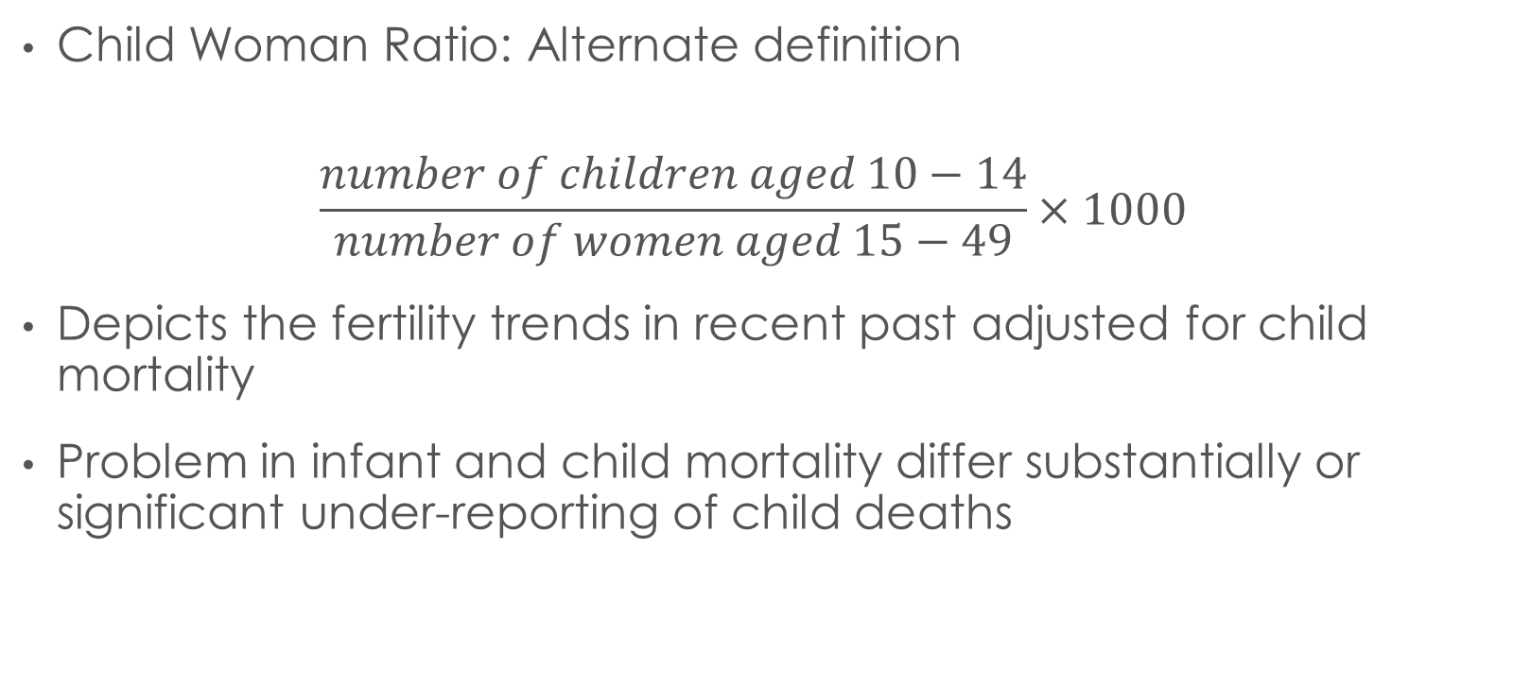
Measures of Fertility
Child Woman Ratio: Alternate definition
$$\frac{number of children aged 10−14}{number of women aged 15−49}×1000$$
Depicts the fertility trends in recent past adjusted for child mortality
Problem in infant and child mortality differ substantially or significant under-reporting of child deaths

Slide 86
Other Period Measures
Crude marriage rate: marriages in year / mid-yr pop
Crude divorce rate: divorces in year / mid-yr pop
General Marriage rate: marriages in year / mid-yr 15+ pop
General divorce rate: divorces in year / mid-yr 15+ pop
Age specific marriage rate (females) : marriages of females in year in age group / mid-yr pop of females in age group
Age specific divorce rate(females) : divorces of females in year in age group / mid-yr pop of females in age group

Slide 87
Cohort Measures of Fertility

Slide 88
Synthetic Cohort measures of fertility
Total Fertility Rate
Total Marital Fertility Rate
Gross Reproductive Rate
Net Reproductive Rate

Slide 89
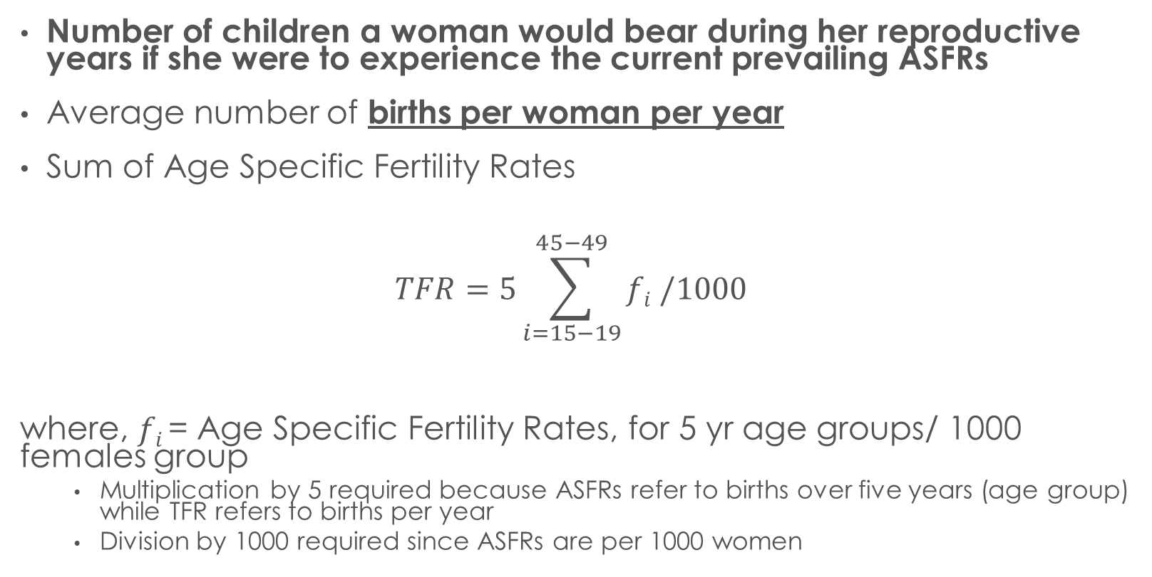
Total fertility rate
Number of children a woman would bear during her reproductive years if she were to experience the current prevailing ASFRs
Average number of births per woman per year
Sum of Age Specific Fertility Rates
$$TFR=5\sum_{i=15−19}^{45−49}{fi /1000}$$
where, $fi$= Age Specific Fertility Rates, for 5 yr age groups/ 1000 females group
    Multiplication by 5 required because ASFRs refer to births over five years (age group) while TFR refers to births per year
    Division by 1000 required since ASFRs are per 1000 women

Slide 90
TFR: a Solved Example
Age Groups | Population | Births | ASFR (per 1000)
15-19 | 464217 | 3000 | 6.46
20-24 | 454027 | 5622 | 12.38
25-29 | 462449 | 2131 | 4.61
30-34 | 449322 | 6413 | 14.27
35-39 | 387132 | 4526 | 11.69
40-44 | 331518 | 3546 | 10.70
45-49 | 280477 | 2369 | 8.45
Total | 2829142 | 27607
 |  | Sum of ASFRs | 68.56
 |  | TFR | = 5 * 68.56 / 1000 = 0.34

Slide 91
 | NFHS-3, Urban India
Age Group | ASFRs (per year)
15-19 | 0.057
20-24 | 0.166
25-29 | 0.123
30-34 | 0.048
35-39 | 0.013
40-44 | 0.004
45-49 | 0.001
Sum of ASFRs | 0.412
Age Group Width | 5
TFR | = 0.412 * 5 = 2.06
Note: ASFRs are depicted as per woman per year. So in calculation of TFR, no need to divide by 1000

Slide 92
 | Age Specific Fertility Rates, India
Age | Urban | Rural | Total
15-19 | 0.057 | 0.105 | 0.09
20-24 | 0.166 | 0.231 | 0.209
25-29 | 0.123 | 0.146 | 0.139
30-34 | 0.048 | 0.069 | 0.062
35-39 | 0.013 | 0.031 | 0.025
40-44 | 0.004 | 0.009 | 0.007
45-49 | 0.001 | 0.004 | 0.003
TFR 15-44 | 2.06 | 2.96 | 2.66
TFR 15-49 | 2.06 | 2.98 | 2.68
CBR | 18.8 | 25 | 23.1
The total fertility rate is almost one child higher in rural areas (3.0) than in urban areas (2.1).
Age-specific fertility rates are lower at all ages in urban areas than in rural areas.
Seventy percent of urban total fertility and 63 percent of rural total fertility are concentrated in the prime childbearing ages 20-29.
There is also a moderate amount of early childbearing at age 15-19.
Fertility at age 15-19 accounts for 14 percent of total fertility in urban areas and 18 percent in rural areas.
Fertility at ages 35 and older accounts for only 4 percent of total fertility in urban areas and 7 percent in rural areas.
Interpret the data ?
Source: NFHS-3

Slide 93
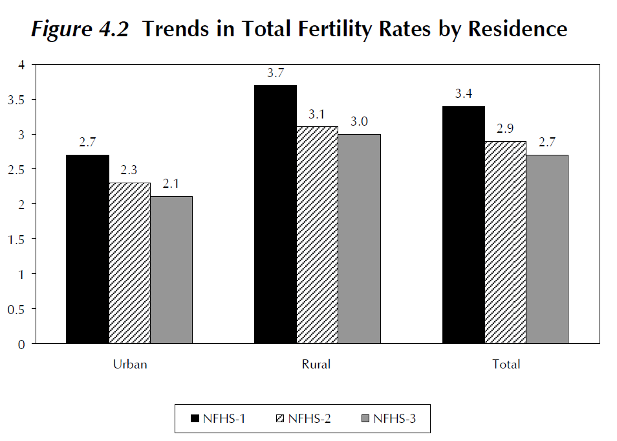
ASFR and TFR in India
Trends based on NFHS data
Age Group | NFHS 3 | NFHS 2 | NFHS 1
15-19 | 0.09 | 0.107 | 0.116
20-24 | 0.209 | 0.21 | 0.231
25-29 | 0.139 | 0.143 | 0.17
30-34 | 0.062 | 0.069 | 0.097
35-39 | 0.025 | 0.028 | 0.044
40-44 | 0.007 | 0.008 | 0.015
45-49 | 0.003 | 0.003 | 0.005
TFR 15-44 | 2.66 | 2.84 | 3.36
TFR 15-49 | 2.68 | 2.85 | 3.39

Slide 94
Replacement level TFR
TFR of 2.1 often referred to as “replacement level fertility”
An average of two children will replace each couple (mother and father)
  Each couple replaced by a couple
  Only if the children survive to reproductive age
  Extra “0.1” added to 2
    to account for mortality
    Unbalanced sex-ratios
If child mortality very high, the replacement level TFR would be higher
  Was as high as 6 in pre-transition populations

Slide 95
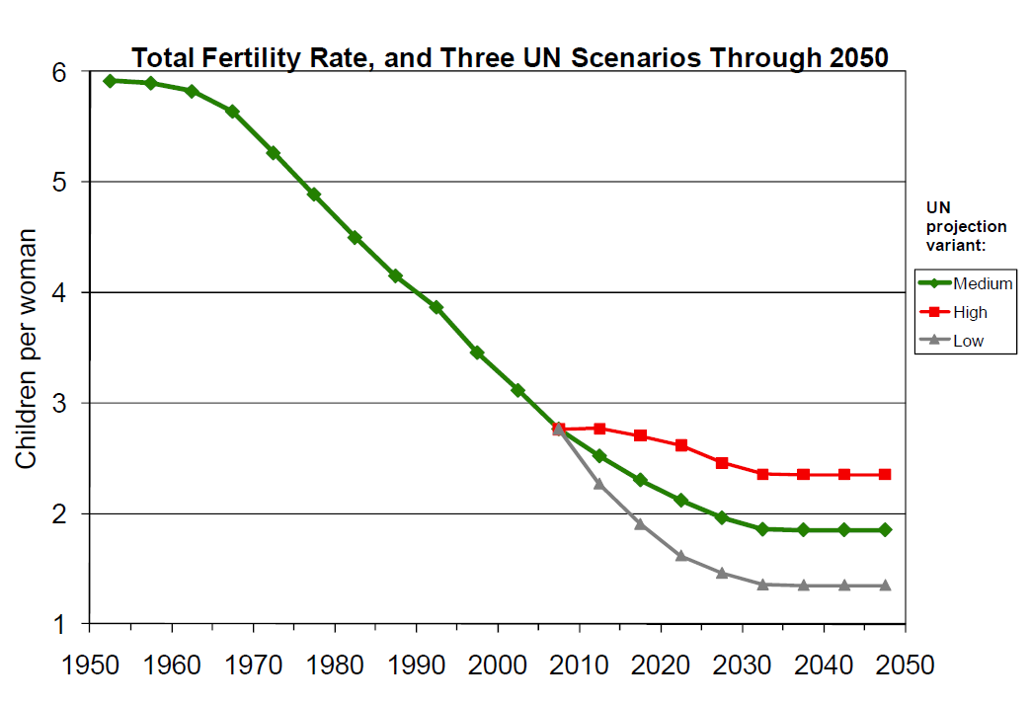
Notes:
http://southasiainstitute.harvard.edu/website/wp-content/uploads/2012/08/Bloom_PopulationdynamicsiIndia.pdf

Slide 96
TFR: disadvantages
Does not measure complete fertility
  Assumes that the current ASFRs will remain constant in future
  Variations in ASFRs may occur due to changes in timing of births without changing total fertility
  Sudden changes in fertility may occur: eg. Baby –boomers after WW2
Ignore marriage status
  Measures average number of children per woman
Does not account for mortality
  Children may die not survive till reproductive years
Different sets of ASFRs may yield same TFR
  Masks age-specific differences in fertility
Does not by itself measure whether the fertility is above of below replacement: better indicators available

Slide 97
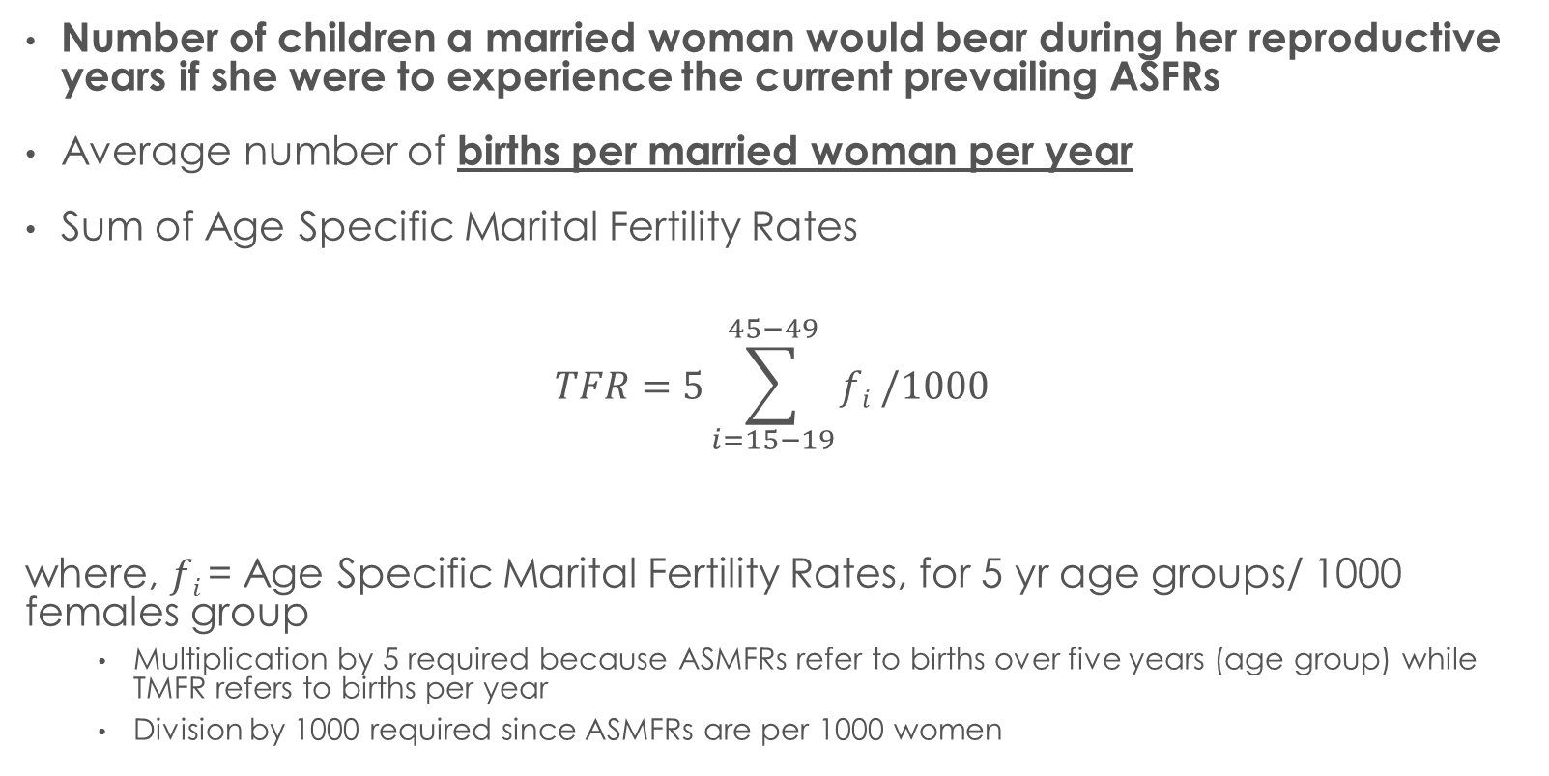
Total MARITAL fertility rate
Number of children a married woman would bear during her reproductive years if she were to experience the current prevailing ASFRs
Average number of births per married woman per year
Sum of Age Specific Marital Fertility Rates
$$TFR=5\sum_{i=15−19}^{45−49}{fi /1000}$$
where, $fi$= Age Specific Marital Fertility Rates, for 5 yr age groups/ 1000 females group
    Multiplication by 5 required because ASMFRs refer to births over five years (age group) while TMFR refers to births per year
    Division by 1000 required since ASMFRs are per 1000 women

Slide 98
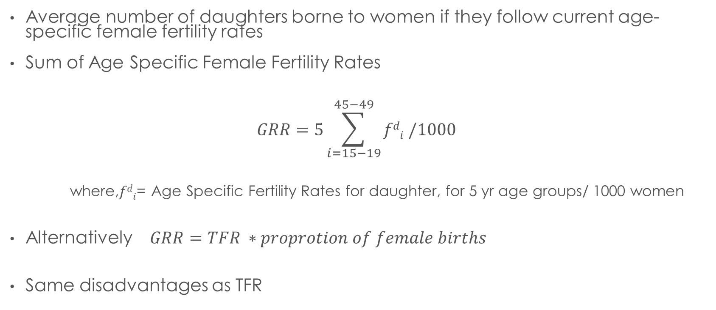
Gross Reproductive rate
Average number of daughters borne to women if they follow current age-specific female fertility rates
Sum of Age Specific Female Fertility Rates
$$GRR=5\sum_{i=15−19}^{45−49}{fdi /1000}$$
where,$fdi$= Age Specific Fertility Rates for daughter, for 5 yr age groups/ 1000 women
Alternatively $GRR=TFR ∗proprotion of female births$
Same disadvantages as TFR

Slide 99
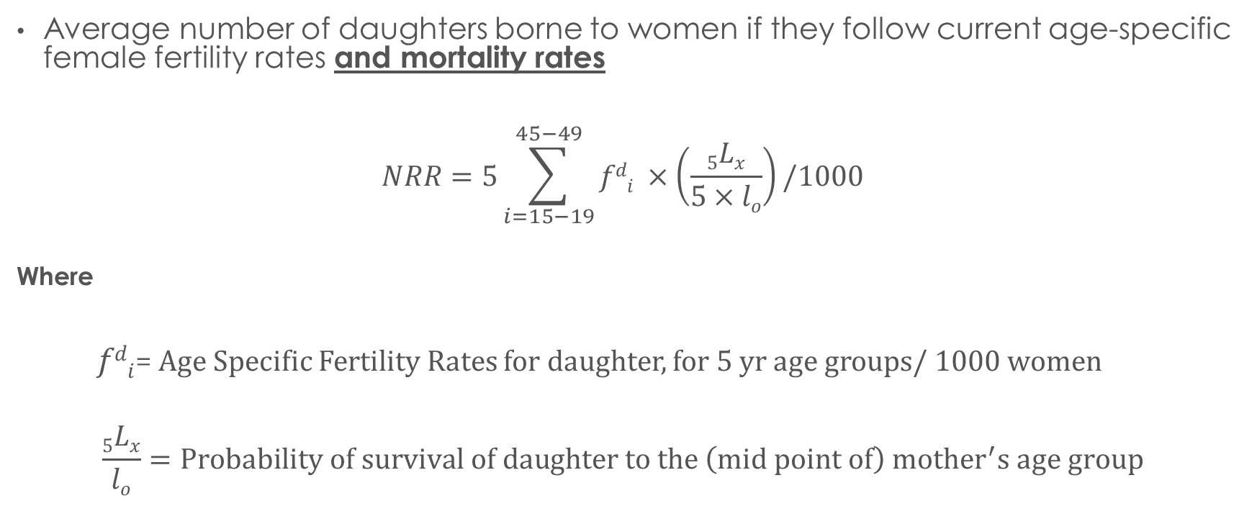
Net Reproductive rate
Average number of daughters borne to women if they follow current age-specific female fertility rates and mortality rates
$$NRR=5\sum_{i=15−19}^{45−49}{fdi ×\left(\frac{5Lx}{5×lo}\right)/1000}$$
Where
$fdi$= Age Specific Fertility Rates for daughter, for 5 yr age groups/ 1000 women
$$\frac{5Lx}{lo}=Probability of survival of daughter to the \left(mid point of\right) mother^{′}s age group$$

Slide 100
NRR
Estimates the number of daughters who will live to replace their mothers in the future
Allows for mortality between birth to the age of mother at the time of bearing the child
  Mortality till daughter becomes the same age that her mother was when daughter was born
Interpretation
  NRR =1 : exact replacement
  NRR >1: above replacement; growth ; future generation of potential mothers will be bigger than the one that produced them
  NRR < 1: below replacement; decline ; future generation of potential mothers will be smaller than the one that produced them

Slide 101
NRR
Assumes that mortality will change little over time
  Assumption often correct in more developed countries
If Mortality high
  NRR << GRR
If mortality low
  NRR ≈ GRR

Slide 102
Measures of Fertility: Compared
Indicator | Numerator | Denominator | Multiplier
GFR | Births in 1 yr | Females 15-49 | 1000
ASFR | Births to women in age group X | Women in Age group X | 1000
TFR | [ (Σ ASFRs )x group interval size] / 1000
GMFR | Births in one year | Married females 15-49 | 1000
GIFR | Illegitimate Births in 1 year | Single, widowed, divorced, separated women 15-49 yrs | 1000

Slide 103
Indices of mortality

Slide 104
Mortality Indicators
Number of deaths
Crude death rate
Age specific death rate
Infant mortality rate
Neonatal mortality Rate
Post-neonatal mortality rate
Perinatal mortality rate
Stillbirth rate

Slide 105
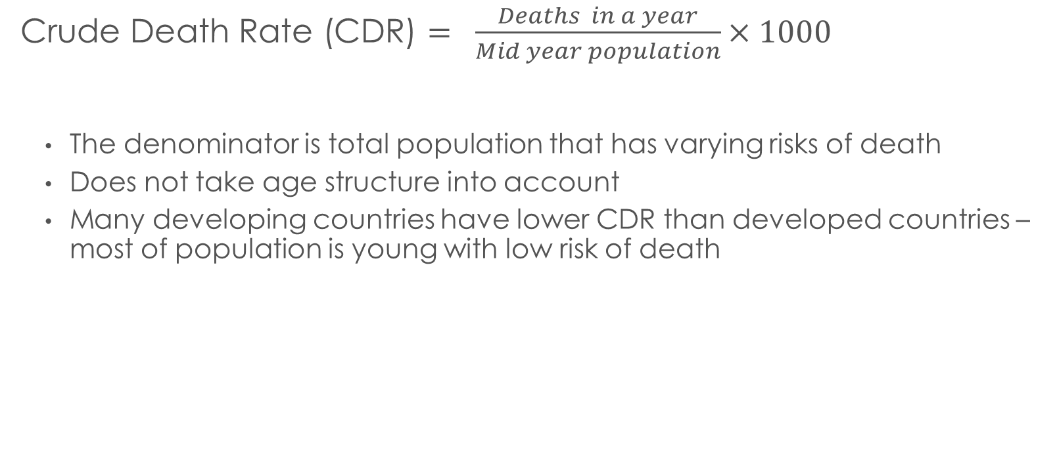
Indices of Mortality
Crude Death Rate (CDR) $= \frac{Deaths in a year}{Mid year population}×1000$
  The denominator is total population that has varying risks of death
  Does not take age structure into account
  Many developing countries have lower CDR than developed countries – most of population is young with low risk of death

Slide 106
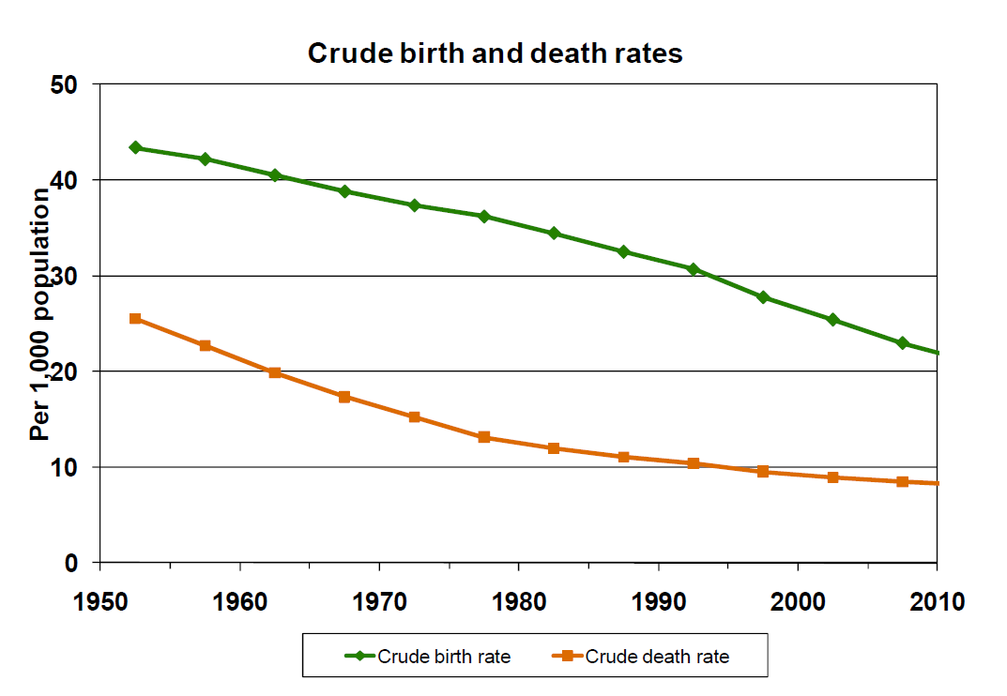
Notes:
http://southasiainstitute.harvard.edu/website/wp-content/uploads/2012/08/Bloom_PopulationdynamicsiIndia.pdf

Slide 107

Age Specific Death Rates
$$\frac{deaths in an year in age group x to x+n}{mid year population in age group x to x+n}×1000$$
J shaped Graph

Slide 108
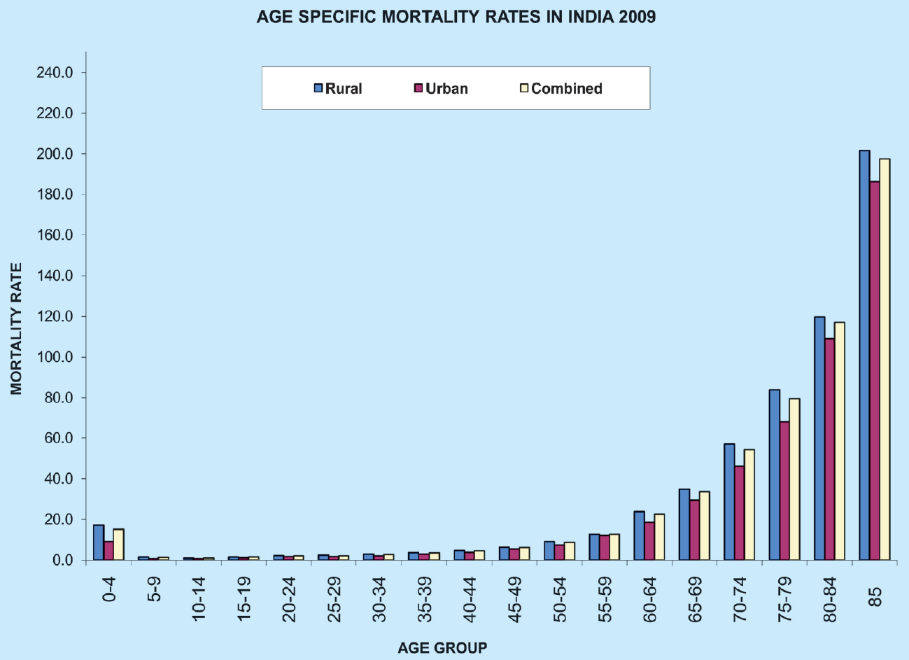
National Health Profile 2011

Slide 109
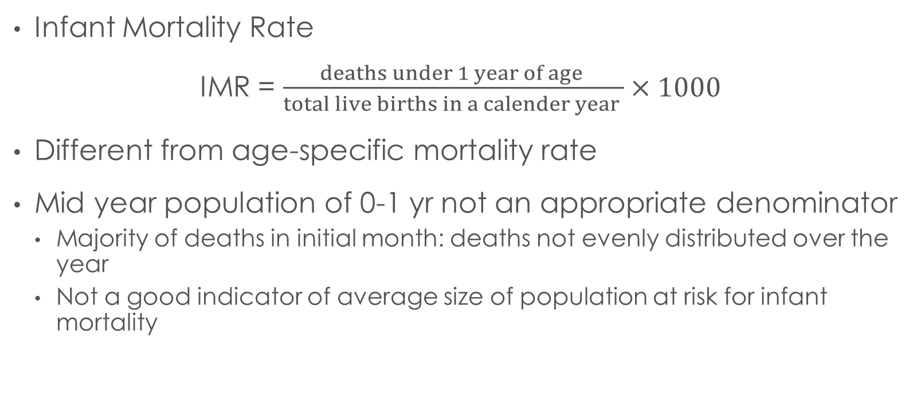
Indices of Mortality
Infant Mortality Rate
IMR = $\frac{deaths under 1 year of age }{total live births in a calender year }×1000$
Different from age-specific mortality rate
Mid year population of 0-1 yr not an appropriate denominator
  Majority of deaths in initial month: deaths not evenly distributed over the year
  Not a good indicator of average size of population at risk for infant mortality

Slide 110
Infant mortality rate
  A ratio and not a rate
    Migrations may affect the numerator but will not affect the denominator
    Denominator includes births in calendar year while deaths may take place among children born in previous year
Often presented as three-year moving averages
    to smoothen year-to-year variations, and
    to overcome effects of births occurring in calendar year while deaths including children born in previous year
Considered sensitive indicator of the status of health of community

Slide 111
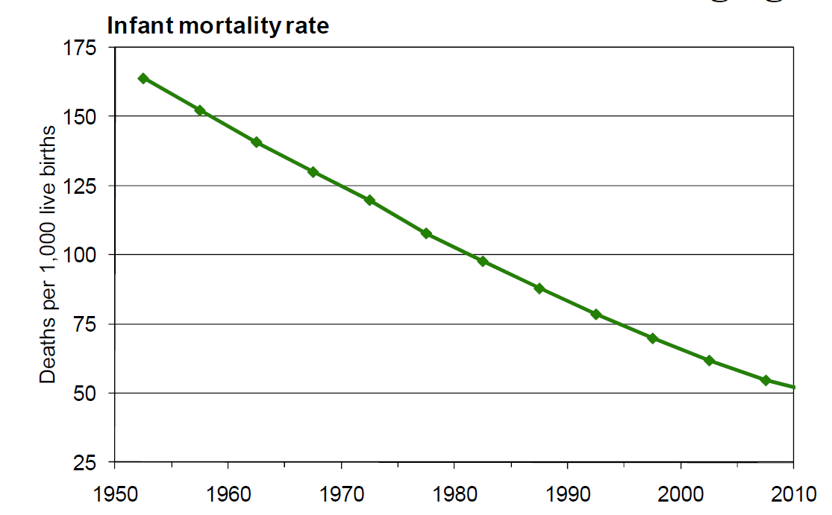
Notes:
http://southasiainstitute.harvard.edu/website/wp-content/uploads/2012/08/Bloom_PopulationdynamicsiIndia.pdf

Slide 112
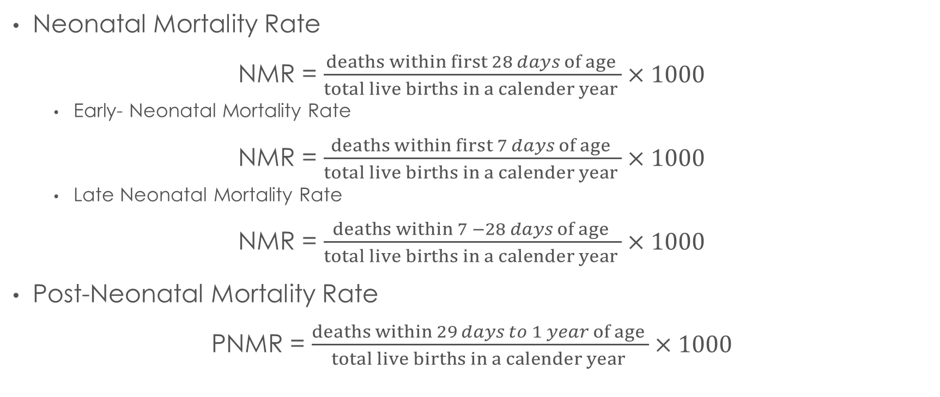
Indices of Mortality
Neonatal Mortality Rate
NMR = $\frac{deaths within first 28 days of age }{total live births in a calender year }×1000$
    Early- Neonatal Mortality Rate
NMR = $\frac{deaths within first 7 days of age }{total live births in a calender year }×1000$
    Late Neonatal Mortality Rate
NMR = $\frac{deaths within 7 −28 days of age }{total live births in a calender year }×1000$
Post-Neonatal Mortality Rate
PNMR = $\frac{deaths within 29 days to 1 year of age }{total live births in a calender year }×1000$

Slide 113
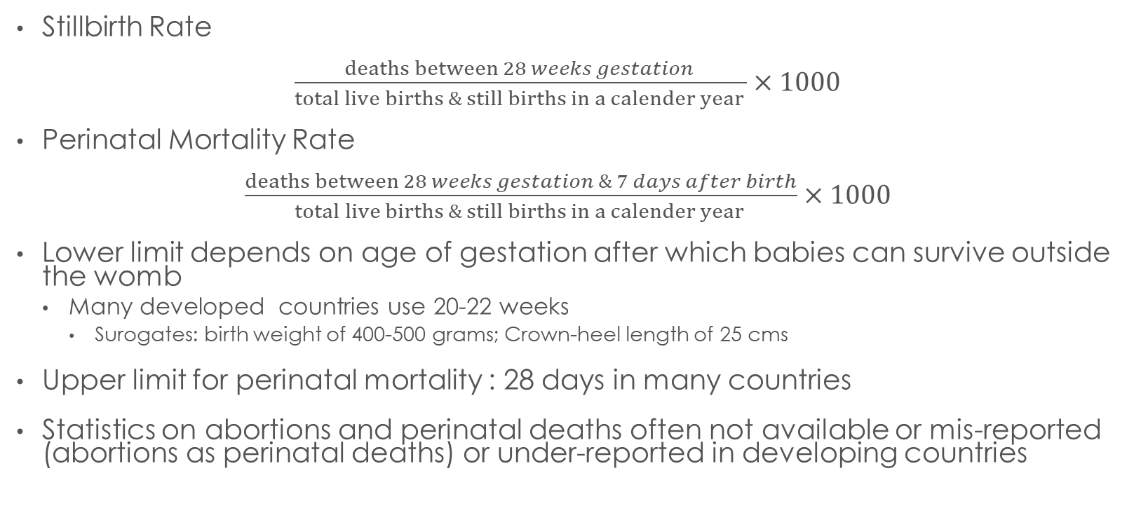
Indices of Mortality
Stillbirth Rate
$\frac{deaths between 28 weeks gestation }{total live births \& still births in a calender year }×1000$
Perinatal Mortality Rate
$\frac{deaths between 28 weeks gestation \& 7 days after birth}{total live births \& still births in a calender year }×1000$
Lower limit depends on age of gestation after which babies can survive outside the womb
  Many developed countries use 20-22 weeks
    Surogates: birth weight of 400-500 grams; Crown-heel length of 25 cms
Upper limit for perinatal mortality : 28 days in many countries
Statistics on abortions and perinatal deaths often not available or mis-reported (abortions as perinatal deaths) or under-reported in developing countries

Slide 114
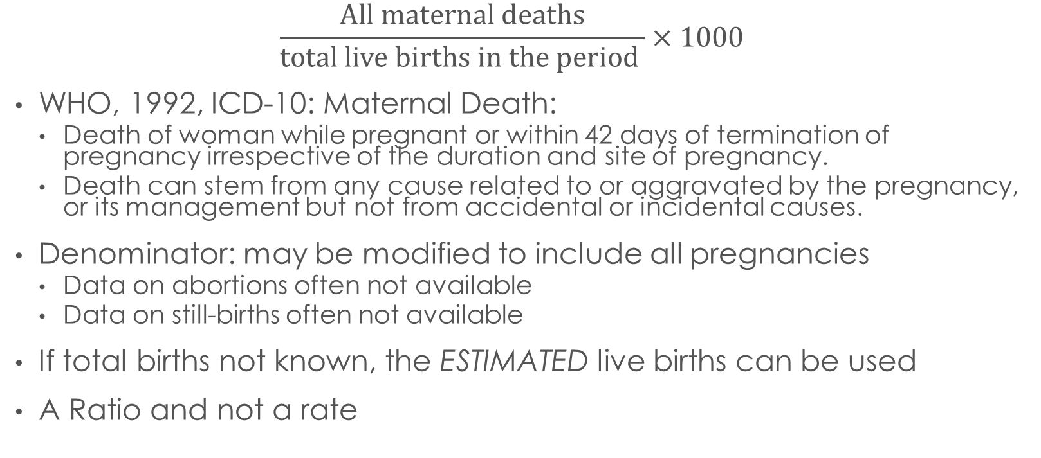
Maternal Mortality Rate
$$\frac{All maternal deaths}{total live births in the period }×1000$$
WHO, 1992, ICD-10: Maternal Death:
  Death of woman while pregnant or within 42 days of termination of pregnancy irrespective of the duration and site of pregnancy.
  Death can stem from any cause related to or aggravated by the pregnancy, or its management but not from accidental or incidental causes.
Denominator: may be modified to include all pregnancies
  Data on abortions often not available
  Data on still-births often not available
If total births not known, the ESTIMATED live births can be used
A Ratio and not a rate

Slide 115
Maternal Mortality Rate
The most widely used measure of
  Maternal death
  Overall health
  Status of women in society
  Gender inequalities
  Health services and systems
Difficulties in measurement
  Comparative rarity
  Reluctance to report abortion related deaths
  Problems of recall
  Lack of medical attribution
  Poor routine registration systems

Slide 116
Maternal Mortality Rate
Often subject to artificial changes
  Under-reported deaths
  Mis-reported deaths
  Improvement in reporting systems
A decreases may not represent real improvements in situation unless the change is sustained over long term
Any changes in MMR must be investigated in light of ongoing interventions and activties
District population | 1,600,000
Live Births | 40,000
Number of Maternal Deaths | MMR (per 100,000 births)
5 | 125
7 | 175
9 | 225
11 | 275
13 | 325

Slide 117
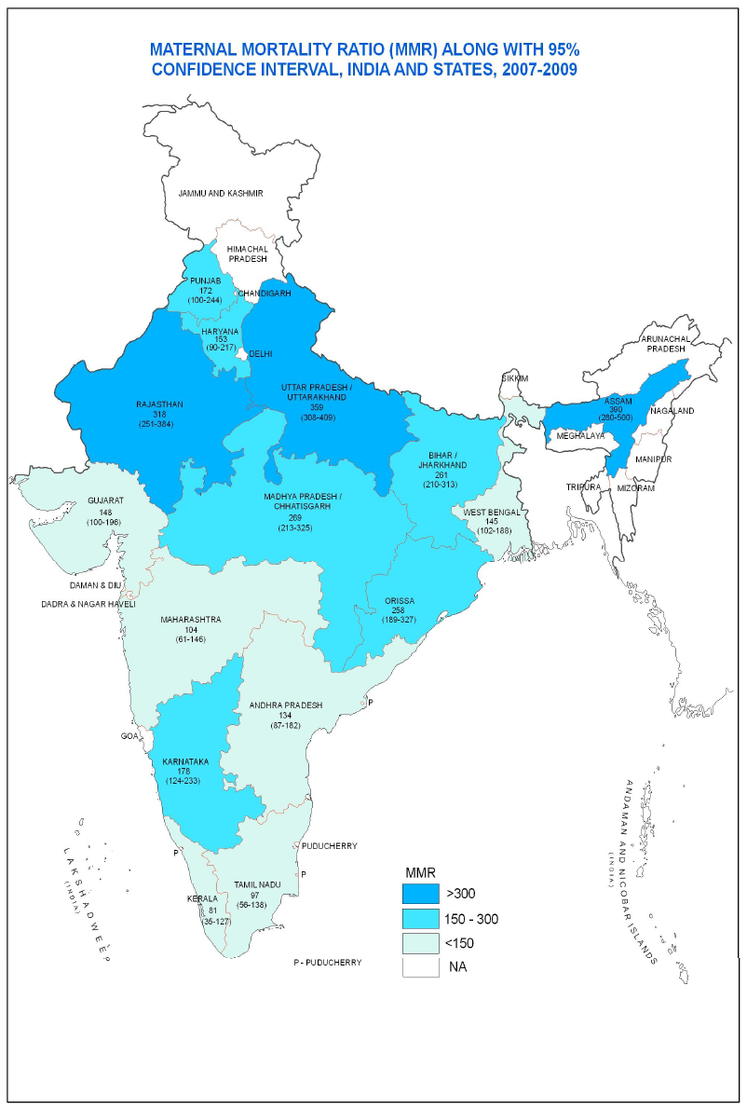
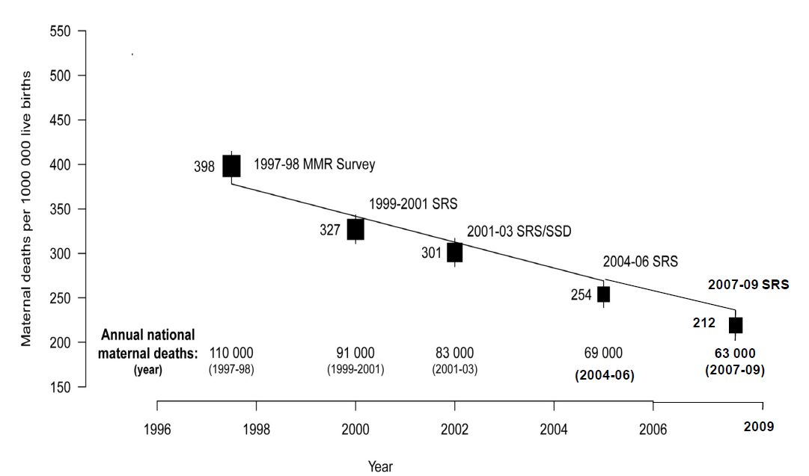
Trends in Maternal Mortality Ratio - India
Notes:
http://censusindia.gov.in/vital_statistics/SRS_Bulletins/MMR_release_070711.pdf

Slide 118
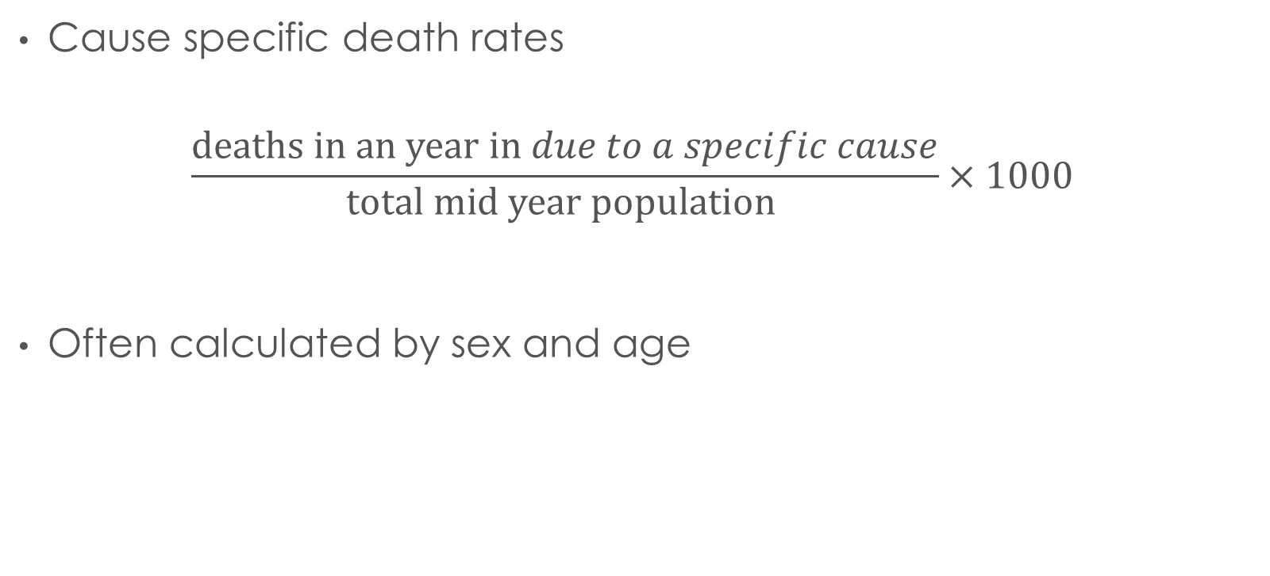
Indices of Mortality
Cause specific death rates
$$\frac{deaths in an year in due to a specific cause}{total mid year population }×1000$$
Often calculated by sex and age

Slide 119
Life Expectation at Birth

Slide 120
Life Tables

Slide 121
Life Tables
A statistical model that combines mortality rates at different age groups in a single setup
Based on conditional probabilities
  ₀P_{n} = ₀P_{n-1} x _{n-1}P_{n}
    Where ₀P_{n} = total probability of surviving period n
    ₀P_{n-1}= total probability of survivng period n-1
    _{n-1}P_{n} = probability of surviving nth period

Slide 122
Life Tables
Complete Life Table – life information is complete for each year of age
Abriged life tables – Age groups used instead of single year
Hypothetical Cohort table – based on age specific death rates in one year projecting them

Slide 123
Smoothening of age Distribution
Moving averages
  For yearly data = Pn-1 + Pn +Pn+1 / 3
  For 5 year age grouped data (Pn-1 + 2Pn + Pn+1) /4
Use of polynomial and other curves

Slide 124
Creating Life Tables
Subtitle

Slide 125
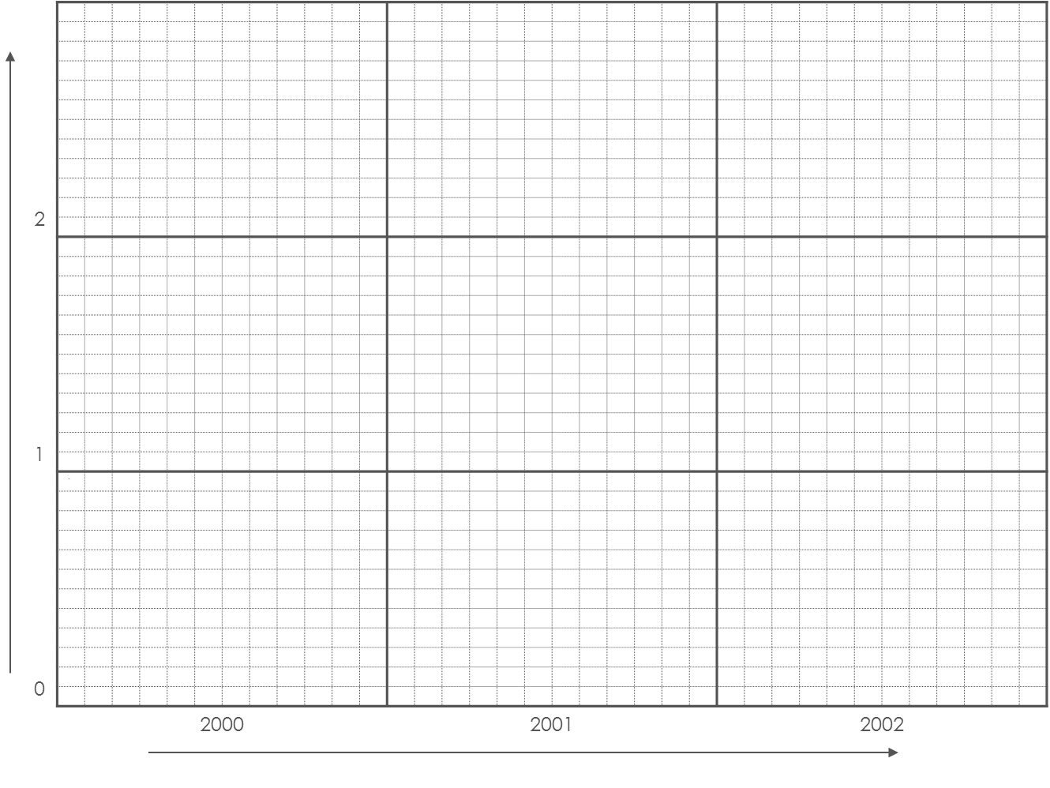
Lexis diagrams
2
1
0 | 0
 | 2000 |  |  |  |  |  |  |  |  |  |  |  | 2001 |  |  |  |  |  |  |  |  |  |  |  | 2002
X Axis: Year
Y Axis: Duration/ Time
Each Small Box: 1 mth

Slide 126
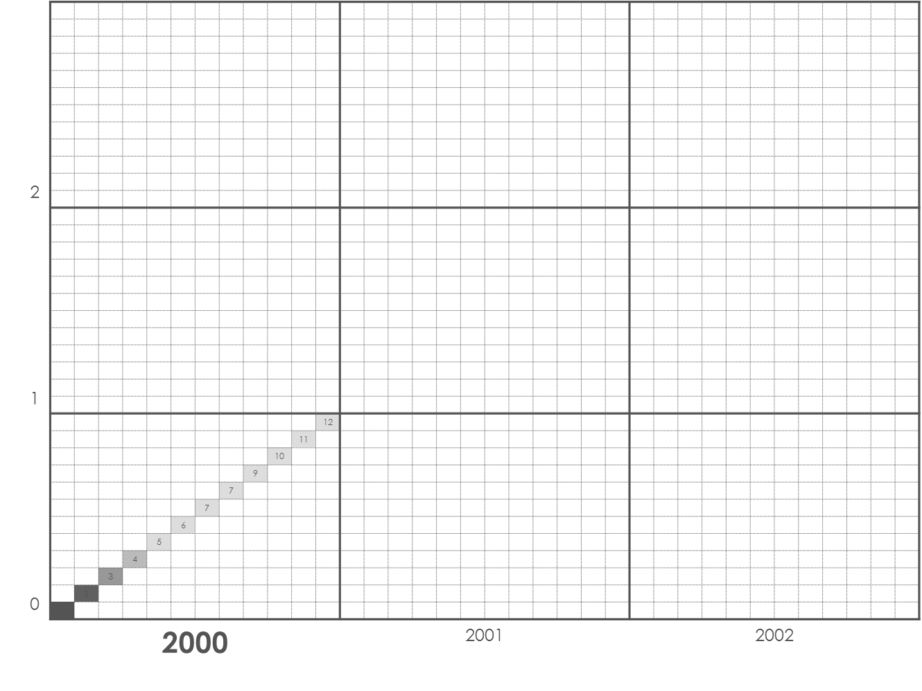
Lexis diagrams
2
1
0 |  |  |  |  |  |  |  |  |  |  |  | 12
 |  |  |  |  |  |  |  |  |  |  | 11
 |  |  |  |  |  |  |  |  |  | 10
 |  |  |  |  |  |  |  |  | 9
 |  |  |  |  |  |  |  | 7
 |  |  |  |  |  |  | 7
 |  |  |  |  |  | 6
 |  |  |  |  | 5
 |  |  |  | 4
 |  |  | 3
 |  | 2
 | 1
 | 2000 |  |  |  |  |  |  |  |  |  |  |  | 2001 |  |  |  |  |  |  |  |  |  |  |  | 2002
Children born in year 2000
Born in first month of year 2000 → Track their progress over Time

Slide 127
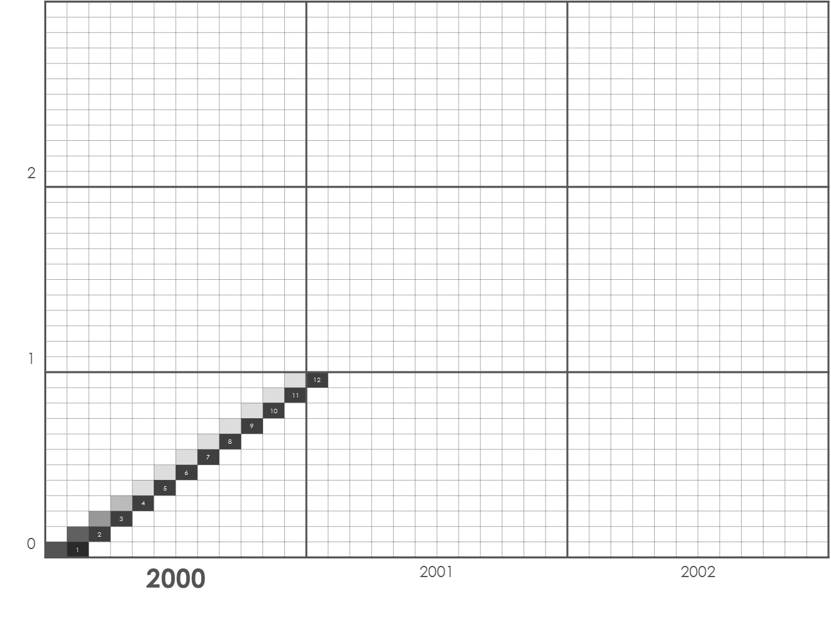
Lexis diagrams
2
1
0 | 0 |  |  |  |  |  |  |  |  |  |  |  | 12
 |  |  |  |  |  |  |  |  |  |  |  | 11
 |  |  |  |  |  |  |  |  |  |  | 10
 |  |  |  |  |  |  |  |  |  | 9
 |  |  |  |  |  |  |  |  | 8
 |  |  |  |  |  |  |  | 7
 |  |  |  |  |  |  | 6
 |  |  |  |  |  | 5
 |  |  |  |  | 4
 |  |  |  | 3
 |  |  | 2
 |  | 1
 | 2000 |  |  |  |  |  |  |  |  |  |  |  | 2001 |  |  |  |  |  |  |  |  |  |  |  | 2002
Children born in year 2000
Born in Second month of year 2000 → Track their progress over Time

Slide 128
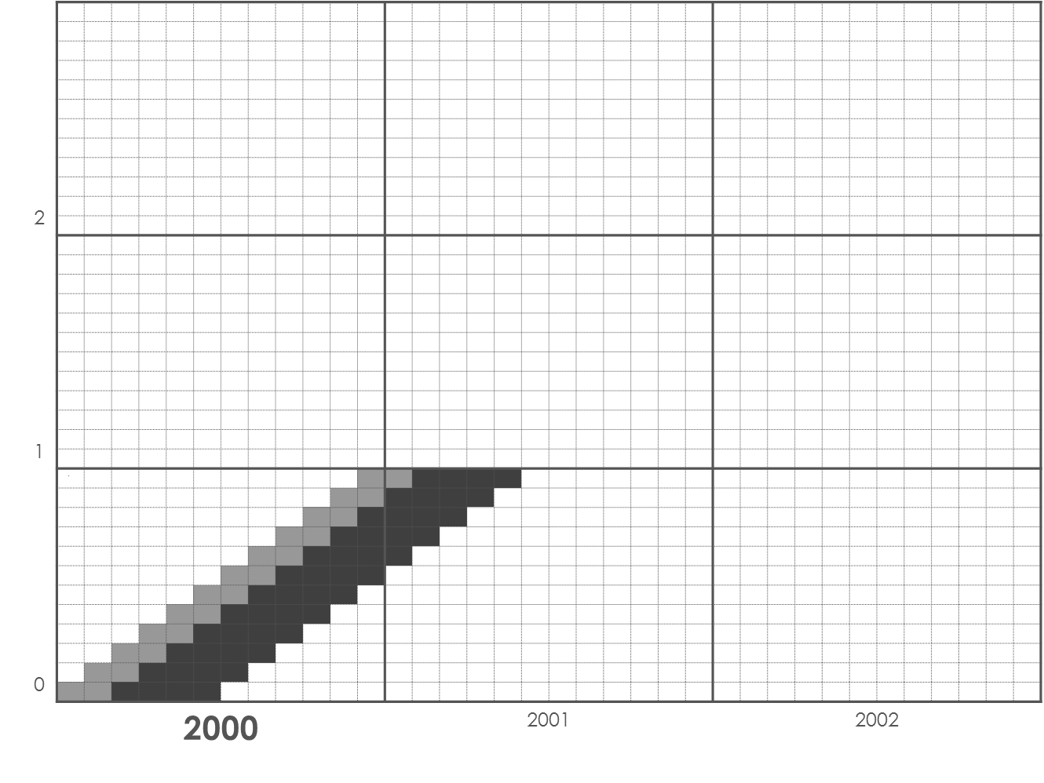
Lexis diagrams
2
1
0 | 0
 | 2000 |  |  |  |  |  |  |  |  |  |  |  | 2001 |  |  |  |  |  |  |  |  |  |  |  | 2002
Children born in year 2000
Born in Third – sixth month of year 2000 → Track their progress over Time

Slide 129
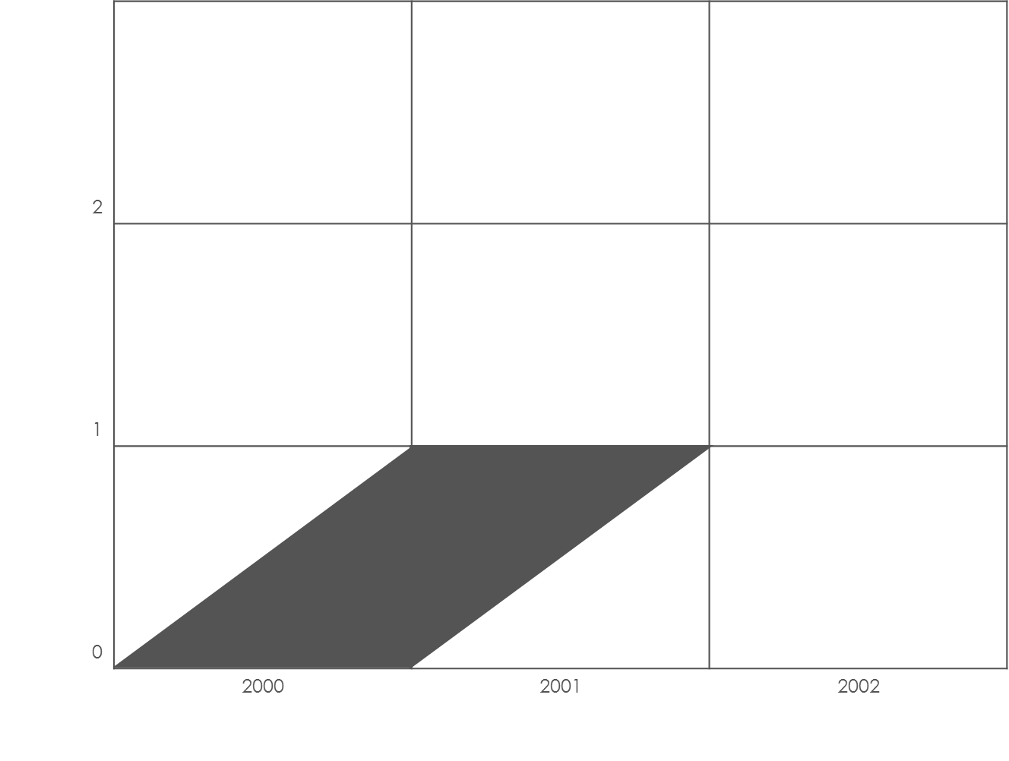
Lexis diagrams
2
1
0
 | 2000 | 2001 | 2002
Shaded Area Represents
the Experience of Children born in year 2000 in first year of their life

Slide 130
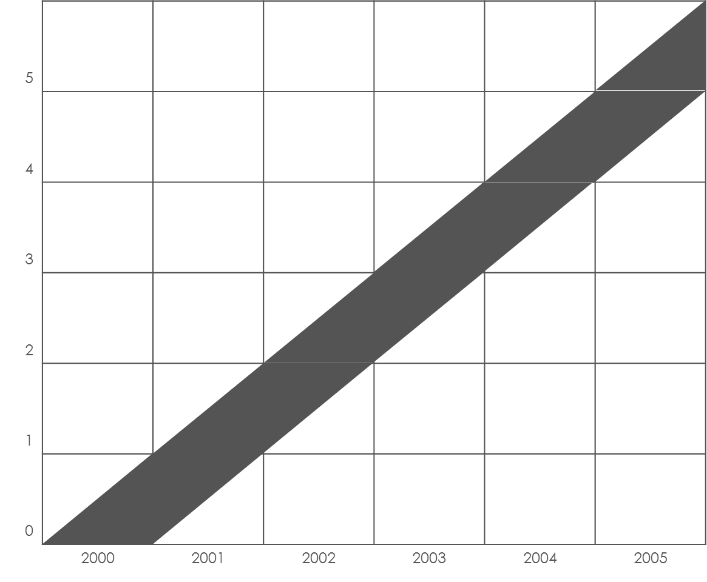
Lexis diagrams
5
4
3
2
1
0
 | 2000 | 2001 | 2002 | 2003 | 2004 | 2005
Shaded Area Represents
the Experience of Children born in year 2000 in initial Five years of their life

Slide 131
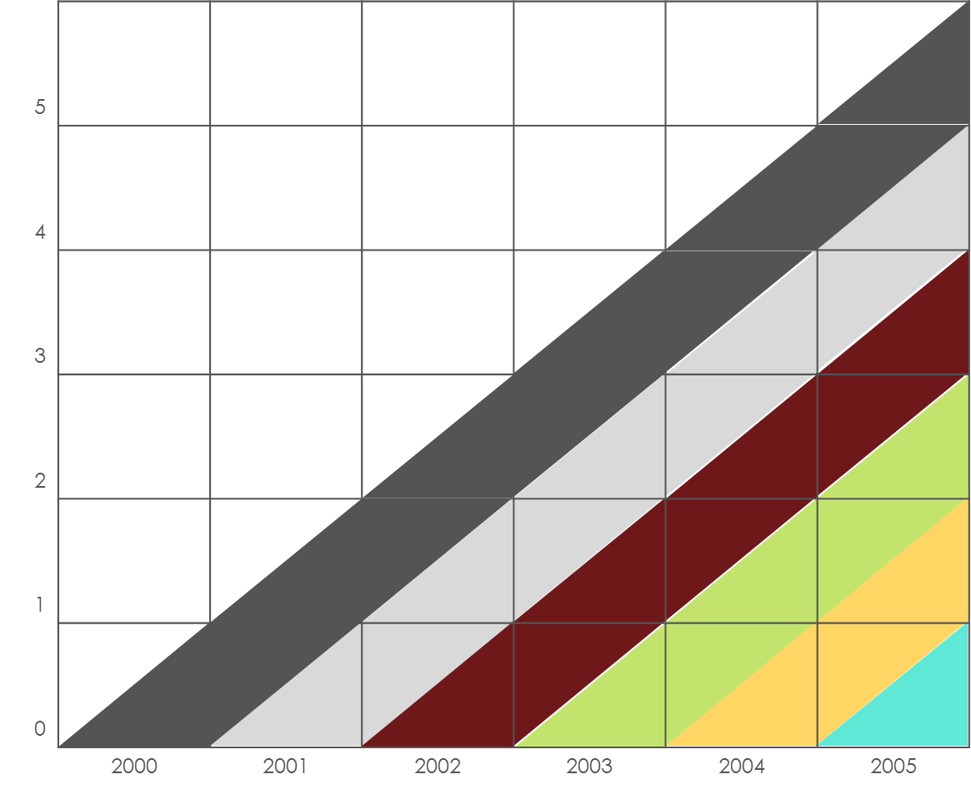
Lexis diagrams
5
4
3
2
1
0
 | 2000 | 2001 | 2002 | 2003 | 2004 | 2005
Each Shaded Area Represents
the Experience of individuals born in the corresponding base year

Slide 132

Lexis diagrams
5
4
3
2
1
0
 | 2000 | 2001 | 2002 | 2003 | 2004 | 2005
Which Area does the Bright Red band represent ?

Slide 133
Lexis diagrams
5
4
3
2
1
0
 | 2000 | 2001 | 2002 | 2003 | 2004 | 2005
Each diagonal band represents a Cohort born in a particular year
Cohorts may have distinctive histories depending on the year of birth: upbringing, environmental influences, social change, access to care
Eg India’s 1982 birth cohort was not vaccinated with measles but majority of the 2012 cohort was vaccinated

Slide 134
Lexis diagrams
5
4
3
2
1
0
 | 2000 | 2001 | 2002 | 2003 | 2004 | 2005
Cohort Analysis
Traces the changing numbers and characteristics of cohorts over their lifetime

Slide 135
Disordered Cohort Flow
Sudden changes due to unusual characteristics of certain cohorts
  Cohorts drastically differ from previous and subsequent cohorts
  Eg
    baby-boomers after the WW-2
    War veterans
    Immigrants

Slide 136
Lexis diagrams
5
4
3
2
1
0
 | 2000 | 2001 | 2002 | 2003 | 2004 | 2005
Period Analysis
A cross section of the population
Eg. Surveys, census
Mix of several cohorts
The information of all these cohorts is summarized to provide summary of the current situation. Eg Life expectancy, Total fertility rates

Slide 137
Synthetic Cohort
Cohorts based on period data
Age specific Rates of current period are applied to a fictitious cohort or a synthetic cohort
  The current period should NOT be an atypical period. Eg: epidemic, war, famine
  Average data over several periods may be used to study the synthetic cohort to
Behavior of fictitious cohort in subsequent periods assumed to be similar to the behavior in current period
  A strong assumption that will definitely get violated: change is inevitable

Slide 138
Life Tables

Slide 139
What Are Life Tables
First conceptualized by John Graunt
  Number surviving at successive ages out of 100 ‘quick conceptions’ or live births
  Using mortality data to obtain proportions surviving at each age
Edmund Halley (1656-1742)
  More rigorous mathematical approach to life tables
  Life tables for the town of Breslau, Germany

Slide 140
Types of Life Tables
Source of data
  Period Life tables
  Cohort life Tables
Amount of detail that is available
  Complete Life Table: each year of age is represented in table
  Abridged Life table: age groups are represented in table

Slide 141
Period Life Tables
Derived form age-specific mortality rates
  Rates observed over one-year
  Averages rates over multiple years
Observed ASMRs applied to a hypothetical / synthetic cohort
  Question of interest: How the hypothetical cohort would change over time if the observed ASMRs are applied to it ?
Helps answer:
    In each n^{th} year, how many from the cohort will die
    At the end of n^{th} years how many from the hypothetical would be alive
    What would be the Life Expectancy at n^{th} year, etc..

Slide 142
Underlying principles for period life tables
Stationary Population
  Constant Size: Number of births = Number of Deaths
  Constant Age Structure: for each stationary population
  Closed to migration: no migration / net-migration is zero
Assumptions often considered unrealistic
Assumptions make calculations simple

Slide 143




Creating Abridged period life Tables: 1
Age Group |  | $$nMx$$
Below 1 | ₁M₀ | 38.7
1-4 | ₄M₁ | 1.4
0-4 | ₅M₀ | 8.6
5-9 | ₅M₅ | 0.6
10-14 | ₅M₁₀ | 0.5
15-19 | ₅M₁₅ | 1.2
20-24 | ₅M₂₀ | 1.6
25-29 | ₅M₂₅ | 1.3
30-34 | ₅M₃₀ | 2.9
35-39 | ₅M₃₅ | 3.4
40-44 | ₅M₄₀ | 3.6
45-49 | ₅M₄₅ | 7.1
50-54 | ₅M₅₀ | 8.1
55-59 | ₅M₅₅ | 13.6
60-64 | ₅M₆₀ | 18.8
65-69 | ₅M₆₅ | 31.8
70-74 | ₅M₇₀ | 44.8
75-79 | ₅M₇₅ | 83
80-84 | ₅M₈₀ | 108.1
85+ | ∞M₈₅ | 169
Observed Data on age-specific deaths
  $nNx$ = mid-period population in age interval $x$to $x+n$
  $nDx$ = deaths between ages $x$and $x +n$ during the period
Calculate Age Specific Death Rates
    $nMx = \frac{nDx}{nNx}×k$
    Where: k = multiplier, per 1000 population / per 1 population
Notes:
Age-specific mortality data for Karnataka, SRS Statistical Report 2011 , India
Capital M is used for Age-specific mortality rates observed from our survey data
Small m is used for Age-specific mortality rates calculated from the life table

Slide 144



Creating Abridged period life Tables: 2
Age Group |  | $$nMx$$ | n | x | $$nqx$$
< 1 | ₁q₀ | 38.7 | 1 | 0 | 0.03796537
1-4 | ₄q₁ | 1.4 | 4 | 1 | 0.005584364
5-9 | ₅q₅ | 0.6 | 5 | 5 | 0.002995507
10-14 | ₅q₁₀ | 0.5 | 5 | 10 | 0.002496879
15-19 | ₅q₁₅ | 1.2 | 5 | 15 | 0.005982054
20-24 | ₅q₂₀ | 1.6 | 5 | 20 | 0.007968127
25-29 | ₅q₂₅ | 1.3 | 5 | 25 | 0.006478943
30-34 | ₅q₃₀ | 2.9 | 5 | 30 | 0.014395632
35-39 | ₅q₃₅ | 3.4 | 5 | 35 | 0.016856718
40-44 | ₅q₄₀ | 3.6 | 5 | 40 | 0.017839445
45-49 | ₅q₄₅ | 7.1 | 5 | 45 | 0.034880865
50-54 | ₅q₅₀ | 8.1 | 5 | 50 | 0.039696153
55-59 | ₅q₅₅ | 13.6 | 5 | 55 | 0.065764023
60-64 | ₅q₆₀ | 18.8 | 5 | 60 | 0.089780325
65-69 | ₅q₆₅ | 31.8 | 5 | 65 | 0.147290412
70-74 | ₅q₇₀ | 44.8 | 5 | 70 | 0.201438849
75-79 | ₅q₇₅ | 83 | 5 | 75 | 0.3436853
80-84 | ₅q₈₀ | 108.1 | 5 | 80 | 0.42550679
85+ | ∞q₈₅ | 169 | Infinity | 85 | 1
Probability of Death between ages $x$and $x +n$
    $$nqx = \frac{ 2n × nMx}{2 + n× nMx}$$
  Where: $nMx$= ASDR per 1 population
  $nMx$needs to be divided by 1000 if it was earlier calculated as per 1000 population
  (derivation of formula of _{n}q_{x})
Everyone in last age group will have to die → ∞q₈₅ will be 1
Probability of death during 1 to 4.99 years = $4q1$
Probability of death during 5 to 9.99 years = $5q5$
Notes:
Age-specific mortality data for Karnataka, SRS Statistical Report 2011 , India

Slide 145


Aletrnative formula for
$$nqx = \frac{ n × nMx}{1 + \left(n −nax\right)× nMx}$$
Where, _{n}a_{x} = Average years of survival within the age group
These have been provided by Coale, Ansley J, Demeny P. Regional Model Life Tables and Stable Populations, Princeton University Press, 1966.
And Chang CJ. Life Tables and Mortality Analysis. Geneva: World Health Organization; 1980.

Slide 146



Creating Abridged period life Tables: 3
Age Group | $$nMx$$ | $$nqx$$ | $$npx$$
< 1 | 38.7 | 0.03796537 | 0.96203463
1-4 | 1.4 | 0.005584364 | 0.994415636
5-9 | 0.6 | 0.002995507 | 0.997004493
10-14 | 0.5 | 0.002496879 | 0.997503121
15-19 | 1.2 | 0.005982054 | 0.994017946
20-24 | 1.6 | 0.007968127 | 0.992031873
25-29 | 1.3 | 0.006478943 | 0.993521057
30-34 | 2.9 | 0.014395632 | 0.985604368
35-39 | 3.4 | 0.016856718 | 0.983143282
40-44 | 3.6 | 0.017839445 | 0.982160555
45-49 | 7.1 | 0.034880865 | 0.965119135
50-54 | 8.1 | 0.039696153 | 0.960303847
55-59 | 13.6 | 0.065764023 | 0.934235977
60-64 | 18.8 | 0.089780325 | 0.910219675
65-69 | 31.8 | 0.147290412 | 0.852709588
70-74 | 44.8 | 0.201438849 | 0.798561151
75-79 | 83 | 0.3436853 | 0.6563147
80-84 | 108.1 | 0.42550679 | 0.57449321
85+ | 169 | 1 | 0
Probability of Survival from age $x$to $x +n$
    $$npx =1 −nqx$$
Everyone in last age group will have to die → ∞p₈₅ will be 0
Probability of surviving from 1 to 4.99 years = $4p1$
Probability of surviving from 5 to 9.99 years = $5p5$
Notes:
Age-specific mortality data for Karnataka, SRS Statistical Report 2011 , India

Slide 147





Creating Abridged period life Tables: 4
Age Group | $$nMx$$ | $$nqx$$ | $$npx$$
< 1 | 38.7 | 0.03796537 | 0.96203463
1-4 | 1.4 | 0.005584364 | 0.994415636
5-9 | 0.6 | 0.002995507 | 0.997004493
10-14 | 0.5 | 0.002496879 | 0.997503121
15-19 | 1.2 | 0.005982054 | 0.994017946
20-24 | 1.6 | 0.007968127 | 0.992031873
25-29 | 1.3 | 0.006478943 | 0.993521057
30-34 | 2.9 | 0.014395632 | 0.985604368
35-39 | 3.4 | 0.016856718 | 0.983143282
40-44 | 3.6 | 0.017839445 | 0.982160555
45-49 | 7.1 | 0.034880865 | 0.965119135
50-54 | 8.1 | 0.039696153 | 0.960303847
55-59 | 13.6 | 0.065764023 | 0.934235977
60-64 | 18.8 | 0.089780325 | 0.910219675
65-69 | 31.8 | 0.147290412 | 0.852709588
70-74 | 44.8 | 0.201438849 | 0.798561151
75-79 | 83 | 0.3436853 | 0.6563147
80-84 | 108.1 | 0.42550679 | 0.57449321
85+ | 169 | 1 | 0
Number Surviving at exact ages $x$
    $$lx+n =lx × npx$$
    (small $l$, rounded off to whole numbers)
$l0$ = Number surviving at age 0 = Initial population
$l1$ = Number surviving at age 1 = Number surviving at age 0 x probability of surviving first year (0-0.99 yr)
    $$l1 =l0 × 1p0$$
$l5$ = Number surviving at age 5 = Number surviving at age 1 x probability of surviving 1-4 years (1-4.99 yr)
    $$l4 =l1 × 4p1$$
Notes:
Age-specific mortality data for Karnataka, SRS Statistical Report 2011 , India

Slide 148


Creating Abridged period life Tables: 4
Age Group | $$nMx$$ | $$nqx$$ | $$npx$$ | $$lx$$
< 1 | 38.7 | 0.03796537 | 0.96203463 | 100000
1-4 | 1.4 | 0.005584364 | 0.994415636 | 96203
5-9 | 0.6 | 0.002995507 | 0.997004493 | 95666
10-14 | 0.5 | 0.002496879 | 0.997503121 | 95380
15-19 | 1.2 | 0.005982054 | 0.994017946 | 95142
20-24 | 1.6 | 0.007968127 | 0.992031873 | 94572
25-29 | 1.3 | 0.006478943 | 0.993521057 | 93819
30-34 | 2.9 | 0.014395632 | 0.985604368 | 93211
35-39 | 3.4 | 0.016856718 | 0.983143282 | 91869
40-44 | 3.6 | 0.017839445 | 0.982160555 | 90321
45-49 | 7.1 | 0.034880865 | 0.965119135 | 88709
50-54 | 8.1 | 0.039696153 | 0.960303847 | 85615
55-59 | 13.6 | 0.065764023 | 0.934235977 | 82216
60-64 | 18.8 | 0.089780325 | 0.910219675 | 76810
65-69 | 31.8 | 0.147290412 | 0.852709588 | 69914
70-74 | 44.8 | 0.201438849 | 0.798561151 | 59616
75-79 | 83 | 0.3436853 | 0.6563147 | 47607
80-84 | 108.1 | 0.42550679 | 0.57449321 | 31245
85+ | 169 | 1 | 0 | 17950
Number Surviving at exact ages $x$
    $$lx+n =lx × npx$$
We assume an initial population for our synthetic cohort : radix, lets say 100,000
Then we keep on calculating $lx$ for each successive age group
    REMEMBER: for calculations , $npx$refers to probability of survival of previous period
Can be interpreted as number entering
any age group
Notes:
Age-specific mortality data for Karnataka, SRS Statistical Report 2011 , India

Slide 149
Creating Abridged period life Tables: 4
Age Group | $$nMx$$ | $$nqx$$ | $$npx$$ | $$lx$$
< 1 | 38.7 | 0.03796537 | 0.96203463 | 100000
1-4 | 1.4 | 0.005584364 | 0.994415636 | 96203
5-9 | 0.6 | 0.002995507 | 0.997004493 | 95666
10-14 | 0.5 | 0.002496879 | 0.997503121 | 95380
15-19 | 1.2 | 0.005982054 | 0.994017946 | 95142
20-24 | 1.6 | 0.007968127 | 0.992031873 | 94572
25-29 | 1.3 | 0.006478943 | 0.993521057 | 93819
30-34 | 2.9 | 0.014395632 | 0.985604368 | 93211
35-39 | 3.4 | 0.016856718 | 0.983143282 | 91869
40-44 | 3.6 | 0.017839445 | 0.982160555 | 90321
45-49 | 7.1 | 0.034880865 | 0.965119135 | 88709
50-54 | 8.1 | 0.039696153 | 0.960303847 | 85615
55-59 | 13.6 | 0.065764023 | 0.934235977 | 82216
60-64 | 18.8 | 0.089780325 | 0.910219675 | 76810
65-69 | 31.8 | 0.147290412 | 0.852709588 | 69914
70-74 | 44.8 | 0.201438849 | 0.798561151 | 59616
75-79 | 83 | 0.3436853 | 0.6563147 | 47607
80-84 | 108.1 | 0.42550679 | 0.57449321 | 31245
85+ | 169 | 1 | 0 | 17950
Number Surviving at exact ages $x$
    $$lx+n =lx × npx$$
We assume an initial population for our synthetic cohort : radix, lets say 100,000
Then we keep on calculating $lx$ for each successive age group
    REMEMBER: for calculations , $npx$refers to probability of survival of previous period
76810 persons have
(a) entered 60-64 yr age group
(b) Celebrated 60th birthday
(c) Survived 55-59 group
Can be interpreted as number entering
any age group
Notes:
Age-specific mortality data for Karnataka, SRS Statistical Report 2011 , India

Slide 150



Creating Abridged period life Tables: 5
Age Group | $$nMx$$ | $$nqx$$ | $$npx$$ | $$lx$$ | $$ndx$$
< 1 | 38.7 | 0.03796537 | 0.96203463 | 100000 | 3797
1-4 | 1.4 | 0.005584364 | 0.994415636 | 96203 | 537
5-9 | 0.6 | 0.002995507 | 0.997004493 | 95666 | 287
10-14 | 0.5 | 0.002496879 | 0.997503121 | 95380 | 238
15-19 | 1.2 | 0.005982054 | 0.994017946 | 95142 | 569
20-24 | 1.6 | 0.007968127 | 0.992031873 | 94572 | 754
25-29 | 1.3 | 0.006478943 | 0.993521057 | 93819 | 608
30-34 | 2.9 | 0.014395632 | 0.985604368 | 93211 | 1342
35-39 | 3.4 | 0.016856718 | 0.983143282 | 91869 | 1549
40-44 | 3.6 | 0.017839445 | 0.982160555 | 90321 | 1611
45-49 | 7.1 | 0.034880865 | 0.965119135 | 88709 | 3094
50-54 | 8.1 | 0.039696153 | 0.960303847 | 85615 | 3399
55-59 | 13.6 | 0.065764023 | 0.934235977 | 82216 | 5407
60-64 | 18.8 | 0.089780325 | 0.910219675 | 76810 | 6896
65-69 | 31.8 | 0.147290412 | 0.852709588 | 69914 | 10298
70-74 | 44.8 | 0.201438849 | 0.798561151 | 59616 | 12009
75-79 | 83 | 0.3436853 | 0.6563147 | 47607 | 16362
80-84 | 108.1 | 0.42550679 | 0.57449321 | 31245 | 13295
85+ | 169 | 1 | 0 | 17950 | 17950
Deaths between at exact ages
    $$ndx =lx × nqx$$
number entering the age-group X probability of dying in the age group
In last age group, all will die
    REMEMBER: for any calculation , $nqx$refers to probability of death of the same period
Notes:
Age-specific mortality data for Karnataka, SRS Statistical Report 2011 , India

Slide 151




Creating Abridged period life Tables: 6
Average Number living over the period $n$ between ages $x$ , $x+n$
(Capital L) $nLx =n × \frac{1}{2} \left(lx+lx+n \right)$
Take the average of persons entering the current age group and the persons entering the next age group. (assumes uniform distribution of mortality)
Approximately these many people will be alive in each single year cohort and there will be $n$such cohorts
Eg ₄$L1 =4 × \frac{1}{2} \left(l1+l5 \right)$
In first year of life risk of death is higher in infants, so $1L0 = \left(0.3 l0+0.7 l1 \right)$
In Last Group $∞ L85 = \frac{l85}{∞M85}$ (where M is expressed as a fraction derivaton)
Notes:
Age-specific mortality data for Karnataka, SRS Statistical Report 2011 , India

Slide 152


Age Group | $$nMx$$ | $$nqx$$ | $$npx$$ | $$lx$$ | $$ndx$$ | $$nLx$$
< 1 | 38.7 | 0.03796537 | 0.96203463 | 100000 | 3797 | 97342
1-4 | 1.4 | 0.005584364 | 0.994415636 | 96203 | 537 | 383739
5-9 | 0.6 | 0.002995507 | 0.997004493 | 95666 | 287 | 477615
10-14 | 0.5 | 0.002496879 | 0.997503121 | 95380 | 238 | 476303
15-19 | 1.2 | 0.005982054 | 0.994017946 | 95142 | 569 | 474285
20-24 | 1.6 | 0.007968127 | 0.992031873 | 94572 | 754 | 470978
25-29 | 1.3 | 0.006478943 | 0.993521057 | 93819 | 608 | 467574
30-34 | 2.9 | 0.014395632 | 0.985604368 | 93211 | 1342 | 462700
35-39 | 3.4 | 0.016856718 | 0.983143282 | 91869 | 1549 | 455474
40-44 | 3.6 | 0.017839445 | 0.982160555 | 90321 | 1611 | 447574
45-49 | 7.1 | 0.034880865 | 0.965119135 | 88709 | 3094 | 435811
50-54 | 8.1 | 0.039696153 | 0.960303847 | 85615 | 3399 | 419578
55-59 | 13.6 | 0.065764023 | 0.934235977 | 82216 | 5407 | 397565
60-64 | 18.8 | 0.089780325 | 0.910219675 | 76810 | 6896 | 366808
65-69 | 31.8 | 0.147290412 | 0.852709588 | 69914 | 10298 | 323824
70-74 | 44.8 | 0.201438849 | 0.798561151 | 59616 | 12009 | 268057
75-79 | 83 | 0.3436853 | 0.6563147 | 47607 | 16362 | 197130
80-84 | 108.1 | 0.42550679 | 0.57449321 | 31245 | 13295 | 122988
85+ | 169 | 1 | 0 | 17950 | 17950 | 106214
$nLx$can be used
to create
population pyramids
If we do a survey in the population where 100,000 births are occurring each year, then we will find $nLx$
proportions of people in each age group

Slide 153



Creating Abridged period life Tables: 7
Total Population Aged $x$ and over: $Tx$
(Capital T) $Tx =\sum_{i=x}^{∞}{ nLx}$
Eg Total population aged 65 and over is given by
$T65 =5L65+5L70+5L75……+ ∞L85$
Interpretation: The number of life years that will be lived by people who are exactly 65 years of age
For last age group, $T85$ = $∞ L85$
Notes:
Age-specific mortality data for Karnataka, SRS Statistical Report 2011 , India

Slide 154


Age Group | $$nMx$$ | $$nqx$$ | $$npx$$ | $$lx$$ | $$ndx$$ | $$nLx$$ | $$Tx$$
< 1 | 38.7 | 0.03796537 | 0.96203463 | 100000 | 3797 | 97342 | 6851560
1-4 | 1.4 | 0.005584364 | 0.994415636 | 96203 | 537 | 383739 | 6754218
5-9 | 0.6 | 0.002995507 | 0.997004493 | 95666 | 287 | 477615 | 6370478
10-14 | 0.5 | 0.002496879 | 0.997503121 | 95380 | 238 | 476303 | 5892863
15-19 | 1.2 | 0.005982054 | 0.994017946 | 95142 | 569 | 474285 | 5416561
20-24 | 1.6 | 0.007968127 | 0.992031873 | 94572 | 754 | 470978 | 4942276
25-29 | 1.3 | 0.006478943 | 0.993521057 | 93819 | 608 | 467574 | 4471298
30-34 | 2.9 | 0.014395632 | 0.985604368 | 93211 | 1342 | 462700 | 4003724
35-39 | 3.4 | 0.016856718 | 0.983143282 | 91869 | 1549 | 455474 | 3541023
40-44 | 3.6 | 0.017839445 | 0.982160555 | 90321 | 1611 | 447574 | 3085549
45-49 | 7.1 | 0.034880865 | 0.965119135 | 88709 | 3094 | 435811 | 2637975
50-54 | 8.1 | 0.039696153 | 0.960303847 | 85615 | 3399 | 419578 | 2202164
55-59 | 13.6 | 0.065764023 | 0.934235977 | 82216 | 5407 | 397565 | 1782586
60-64 | 18.8 | 0.089780325 | 0.910219675 | 76810 | 6896 | 366808 | 1385021
65-69 | 31.8 | 0.147290412 | 0.852709588 | 69914 | 10298 | 323824 | 1018213
70-74 | 44.8 | 0.201438849 | 0.798561151 | 59616 | 12009 | 268057 | 694390
75-79 | 83 | 0.3436853 | 0.6563147 | 47607 | 16362 | 197130 | 426332
80-84 | 108.1 | 0.42550679 | 0.57449321 | 31245 | 13295 | 122988 | 229202
85+ | 169 | 1 | 0 | 17950 | 17950 | 106214 | 106214
$Tx$ tells us the number of years people in each age group will live
Eg. The 100,000 infants just born still have 6,851,560 years of life ahead of them

Slide 155


Creating Abridged period life Tables: 8
Life Expectancy at age $x$: Average number of years lived by a person aged $x$ = $ex$
The number of life years that will be lived by people who are exactly $x$years of age divided by the number of people who are aged $x$year
$$ex =\frac{Tx}{lx}$$
Eg. $e1 =\frac{T1}{l1}$
Can be calculated for each age
Notes:
Age-specific mortality data for Karnataka, SRS Statistical Report 2011 , India

Slide 156



Age Group | $$nMx$$ | $$nqx$$ | $$npx$$ | $$lx$$ | $$ndx$$ | $$nLx$$ | $$Tx$$ | $$ex$$
< 1 | 38.7 | 0.03796537 | 0.96203463 | 100000 | 3797 | 97342 | 6851560 | 68.5
1-4 | 1.4 | 0.005584364 | 0.994415636 | 96203 | 537 | 383739 | 6754218 | 70.2
5-9 | 0.6 | 0.002995507 | 0.997004493 | 95666 | 287 | 477615 | 6370478 | 66.6
10-14 | 0.5 | 0.002496879 | 0.997503121 | 95380 | 238 | 476303 | 5892863 | 61.8
15-19 | 1.2 | 0.005982054 | 0.994017946 | 95142 | 569 | 474285 | 5416561 | 56.9
20-24 | 1.6 | 0.007968127 | 0.992031873 | 94572 | 754 | 470978 | 4942276 | 52.3
25-29 | 1.3 | 0.006478943 | 0.993521057 | 93819 | 608 | 467574 | 4471298 | 47.7
30-34 | 2.9 | 0.014395632 | 0.985604368 | 93211 | 1342 | 462700 | 4003724 | 43.0
35-39 | 3.4 | 0.016856718 | 0.983143282 | 91869 | 1549 | 455474 | 3541023 | 38.5
40-44 | 3.6 | 0.017839445 | 0.982160555 | 90321 | 1611 | 447574 | 3085549 | 34.2
45-49 | 7.1 | 0.034880865 | 0.965119135 | 88709 | 3094 | 435811 | 2637975 | 29.7
50-54 | 8.1 | 0.039696153 | 0.960303847 | 85615 | 3399 | 419578 | 2202164 | 25.7
55-59 | 13.6 | 0.065764023 | 0.934235977 | 82216 | 5407 | 397565 | 1782586 | 21.7
60-64 | 18.8 | 0.089780325 | 0.910219675 | 76810 | 6896 | 366808 | 1385021 | 18.0
65-69 | 31.8 | 0.147290412 | 0.852709588 | 69914 | 10298 | 323824 | 1018213 | 14.6
70-74 | 44.8 | 0.201438849 | 0.798561151 | 59616 | 12009 | 268057 | 694390 | 11.6
75-79 | 83 | 0.3436853 | 0.6563147 | 47607 | 16362 | 197130 | 426332 | 9.0
80-84 | 108.1 | 0.42550679 | 0.57449321 | 31245 | 13295 | 122988 | 229202 | 7.3
85+ | 169 | 1 | 0 | 17950 | 17950 | 106214 | 106214 | 5.9
$ex$ tells us the average life years that will be lived by those who are $x$ year of age
Here:
$e0$ = 68.5 year
$e1$ = 70.2 year
Can you explain,
Why $e1 > e0$

Slide 157
Using Period Life Tables
If we have a cohort of children who follow the observed mortality patterns, what would be
  Life expectancies
  Total person-years lived
  Proportion in various age groups at any given point of time
More complex life tables account for
  Gender differentials in mortality
  Migrations
  Fertility patterns etc
Model life tables are routinely prepared by census agencies:
  Eg. SRS Model Life Tables

Slide 158
Period life expectancies are a useful measure of mortality rates actually experienced over a given period and, for past years, provide an objective means of comparison of the trends in mortality over time, between areas of a country and with other countries.
Period life expectancies are sometimes mistakenly interpreted by users as allowing for subsequent mortality changes. Period life expectancy answers the question ‘For a group of people aged x in a given year, how long would they live, on average, if they experienced the age-specific mortality rates above age x of the period in question over the course of their remaining lives?’
Notes:
http://www.ons.gov.uk/ons/guide-method/method-quality/specific/population-and-migration/demography/guide-to-period-and-cohort-life-expectancy/index.html

Slide 159
Cohort life expectancies, even for past years, usually require projected mortality rates for their calculation and hence, in such cases, involve an element of subjectivity.
The cohort life expectancy answers the question ‘For a group of people aged x in a given year, how long would we expect them to live, on average, if they experienced the actual or projected future age-specific mortality rates not from the given year but from the series of future years in which they will actually reach each succeeding age if they survive?’ If mortality rates at age x and above are projected to decrease in future years, the cohort life expectancy at age x will be greater than the period life expectancy at age x.

Slide 160
Beyond Simple…life can be very complicated

Slide 161
Stable Population
Will grow
Will probably not alter its age-sex structure much

Slide 163

derivation of formula of $qx$ FOR SINGLE YEAR
Probability of death = observed deaths among persons aged $x$on last birthday / initial population with age $x$
We know the mid-year population but do not know initial population.
Assuming death events are evenly spread over the year, then the initial population = mid year population + ½ annual deaths
$$qx = \frac{Dx}{Px + 0.5 Dx}$$
Where: $Dx$= observed deaths among persons aged x on last birthday
$Px$= Observed Mid-year population
However we do not know the $Dx$and $Px$. But we know $Mx$and $Mx$= $Dx/Px$
Divide both numerator and denominator by $Px$
$qx = \frac{Dx/Px}{1 + 0.5 Dx/Px}$ = $\frac{Mx}{1 + 0.5 Mx}$ = $\frac{2Mx}{2 + Mx}$

Slide 164

derivation of formula of _{n}$qx$ FOR GROUPED DATA
Probability of death needs to be calculated over $n$Years for age-group ( $x, x+n$ )
1. We need to calculate the total number of deaths for age-group ( $x, x+n$ ) that will occur over the $n$years (since we need probability over n years)
2. We need to calculate the Initial population for age-group ( $x, x+n$ )
1. Knowing that $nDx$deaths occur in 1 year in the age-group, then total number of deaths over $n$years in the age-group = $n ×nDx$
2. Assuming that mid-year population approximates the average population over $n$years and that the death events are evenly spread over $n$years, then the initial population of age group = mid year population + ½ total deaths over $n y$ears
    $nqx = \frac{n × nDx}{nPx + n × 0.5 nDx}$ $= \frac{ 2n × nMx}{2 + n × nMx}$
Where: $nDx$= Observed deaths for age-group ( $x, x+n$ ) in 1 year
$nPx$= Observed Mid-year population for age-group ( $x, x+n$ ), AND
$nMx$= Age Specific death rates for age-group ( $x, x+n$ )

Slide 165

derivation of formula of $∞ L85$ FOR LAST GROUP
$∞ m85 = \frac{∞d85}{∞L85}$ ⋙ $∞ L85 = \frac{∞d85}{∞m85}$
Where $∞ m85$ is the calculated age specific death rate from life table death
Now assuming, $∞ m85$ is approximately equal to $∞ M85$
And for last age group, everyone who enterd the age group will die and thereby $∞d85$ = $l85$
Therefore,
$$∞ L85 = \frac{l85}{∞M85}$$

Slide 166
derivation of formula of $nqx$ FOR GROUPED DATA

